Slide 1
Division for Aging Services
AAA Director Orientation
May 23, 2024

Slide 2
Agenda
Welcome/Opening/Agenda Review
Using the AMR and AMR-OC
Priority/Order of Spending
Major Disaster Declaration
Review of Definition
Flexible Spending
PeerPlace/Programmatic Data
Question and Answer

Slide 3
Providers’ Portal
vda.virginia.gov

Slide 4
SharePoint Links

Slide 5
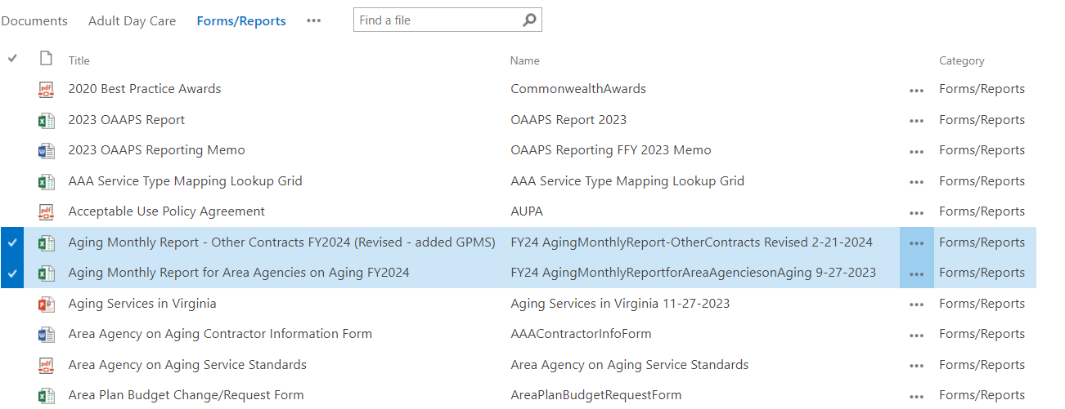
Aging Monthly Reports

Slide 6
Aging Monthly Report (AMR)
Expenditures Reported
Title III-B, C(1) and C(2), III-D, VII- Ombudsman, & VII-Elder Abuse
Title III-E & Title III-E Grandparents
General Funds, Other Local and Other Federal Funds
COVID 19 MDD
VICAP
Respite Care Initiative

Slide 7
Aging Monthly Report–Other Contracts (AMR-OC)
Expenditures Reported
American Rescue Plan (ARP)
Expanding Public Health Workforce
NWD Grant Fund
Directed Appropriations
Falls Prevention
SNAP
Title V

Slide 8
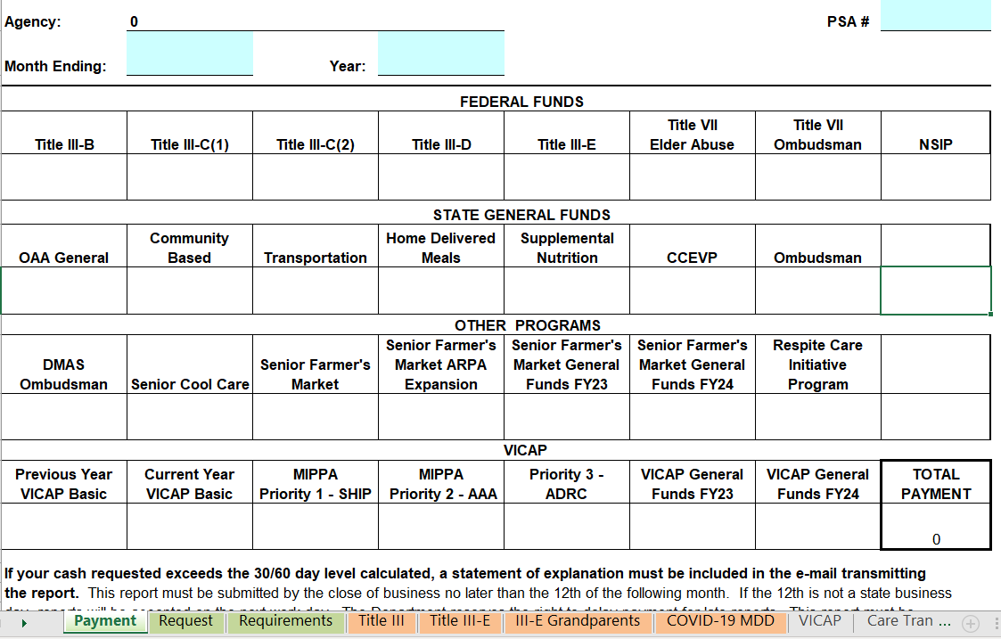
AMR – Payment

Slide 9
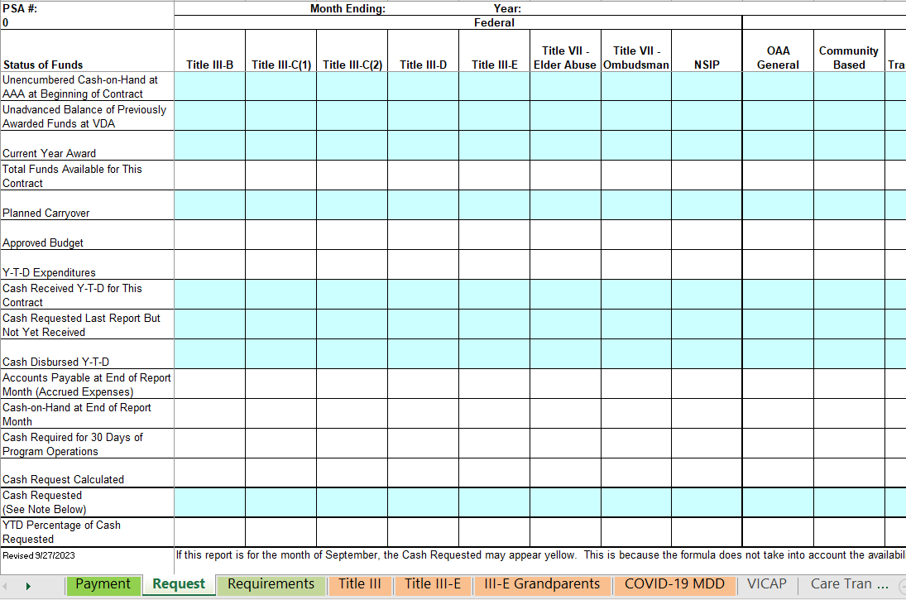
AMR - Request

Slide 10
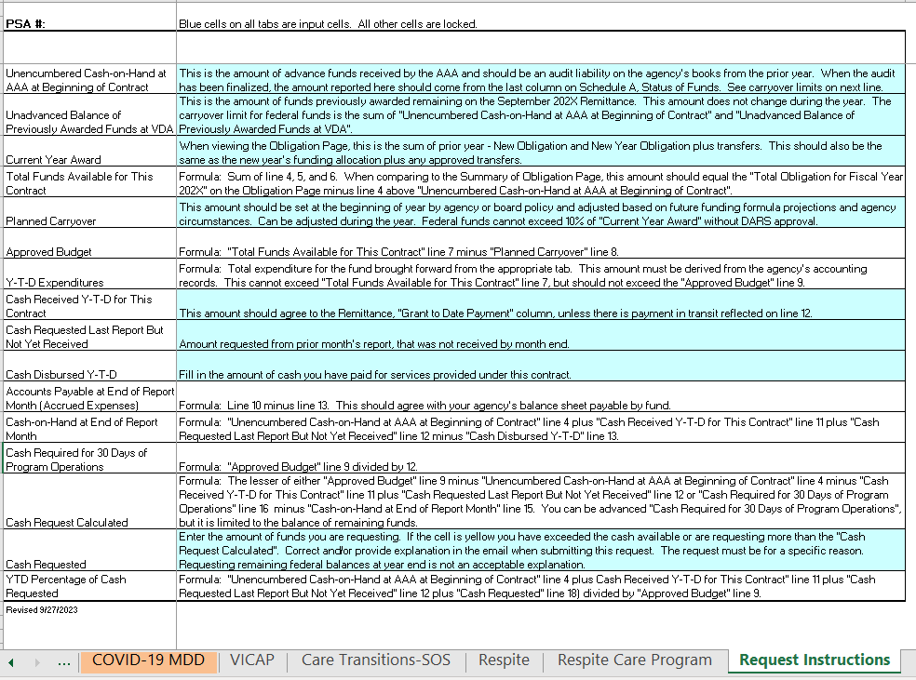
AMR – Request Instructions

Slide 11
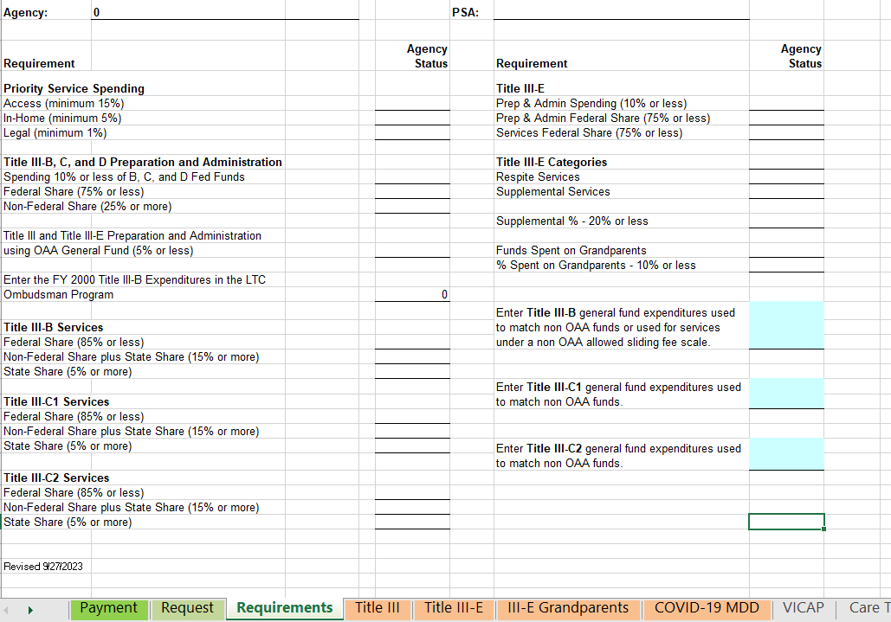
AMR - Requirements

Slide 12
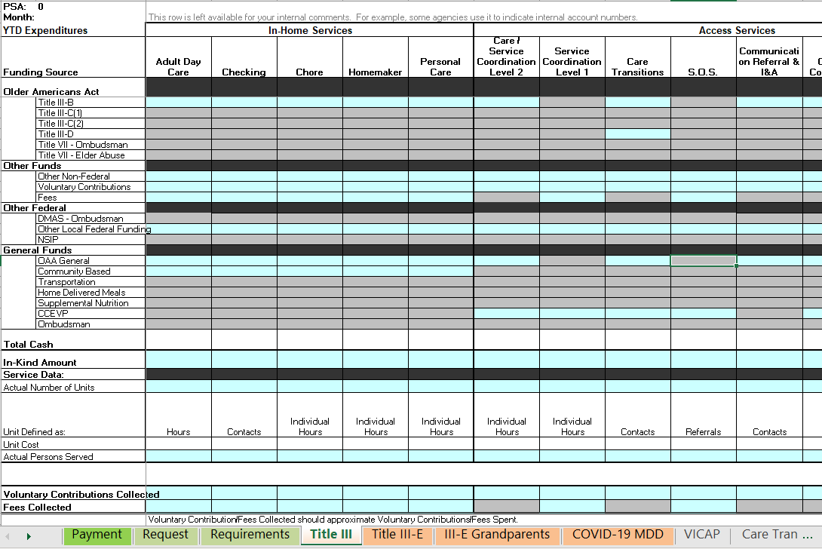
AMR - Expenditures

Slide 13
SharePoint Links

Slide 14
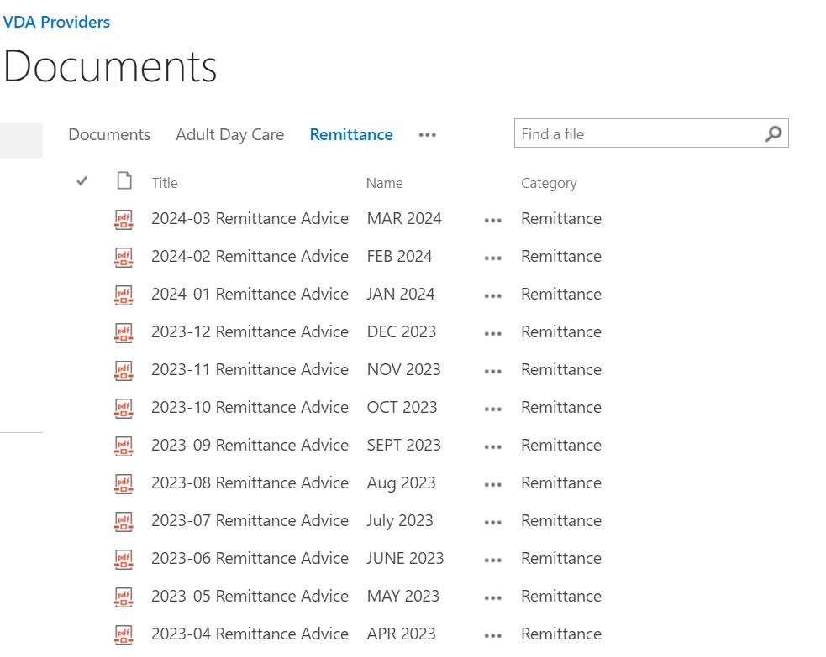
Monthly Remittances

Slide 15
Remittance Example

Slide 16
Priority Order of Spending
State Funds
ARPA
Public Health Workforce
Regular OAA funds starting with FY2023, then the FY2024 current award

Slide 17
Carryover
10% Federal award carryover limit is waived for FY2024 OAA funds
The Code of Virginia 22VAC30-60-440 states: “Carry-over funds may represent obligated but unspent funds. For such funds to be available for expenditure in a subsequent fiscal year, the Virginia Department for Aging and Rehabilitative Services must reauthorize in the subsequent area plan such funds for an area agency to obligate and expend. An Area Agency on Aging shall request authority for such reauthorization of funds.
Please submit a waiver form requesting carryover in excess of 10%

Slide 18
Major Disaster Declaration
On March 13, 2020, the President declared that the ongoing Coronavirus Disease 2019 (COVID-19) pandemic is of sufficient severity and magnitude to warrant an emergency determination.
Permits AAA to use any portion of the funds made available under any and all sections of the OAA for disaster relief for older individuals. In this regard, flexibility is provided to AAAs – without the need for a separate application, transfer request, or request for a waiver - to use existing allocations already made to them under Title III-B, C-1, C-2, D, and E.
This means that a AAA may use Title III-B, C-1, C-2, D, and E funds for any disaster relief activities for older individuals or family caregivers served under the OAA.

Slide 19
Flexibilities
Even though the COVID-19 state of emergency expired, the Major Disaster Declaration (MDD) did not expire.
Flexibility is provided to AAAs to use existing allocations already made under Title III-B, C1, C2, D and E of the OAA.
There is no need to request a budget transfer for ARPA or FY2023 OAA funds in order to utilize these flexibilities.
For example, III-C2 funding typically used for home delivered meals can be used for costs associated with providing in-home services (III-B).

Slide 20
Flexibilities continued
Another example – III-C1 funding associated with congregate meals can be used for costs related to caregiver counseling (III-E).
FY 2023 OAA funding sources (III-B, C1, C2, D and E) can be used for any service listed on the AMR ‘COVID 19’ tab.
ARPA funding sources (III-B, C1, C2, D and E) can be used for any service listed on the AMR-OC ‘American Rescue Plan (ARP)’ tab.
Does not apply to FY2024 OAA or later funding.
The following slides will address this process.

Slide 21
AMR - FY2023 COVID 19 MDD

Slide 22
AMR - Data Entry Example 1 (FY23)

Slide 23
AMR - Data Entry Example 2 (FY23)

Slide 24
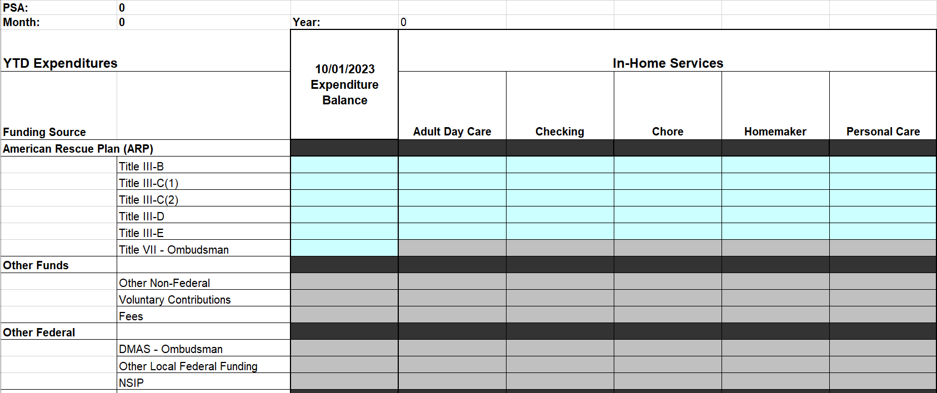
AMR-OC - ARP MDD Example 1

Slide 25
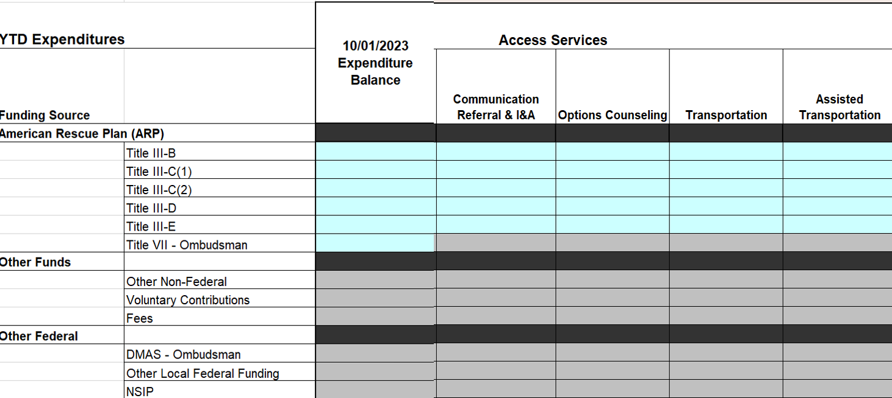
AMR-OC - ARP MDD Example 2

Slide 26
PeerPlace Service Units
Any expenditures claimed under COVID-19 (FY2023 OAA) or the MDD (ARPA) spreadsheets must be accompanied by service units.
Any expenditures claimed under COVID-19 must have service units entered into PeerPlace with a funding source of ‘COVID-19’.
Any expenditures claimed under ARP must have service units entered into PeerPlace with the state service type being ‘ARP’.

Slide 27
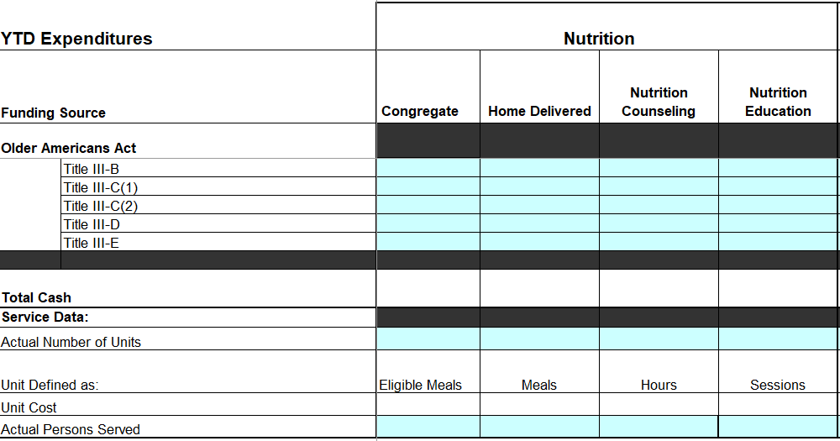
AMR - COVID-19 Units

Slide 28
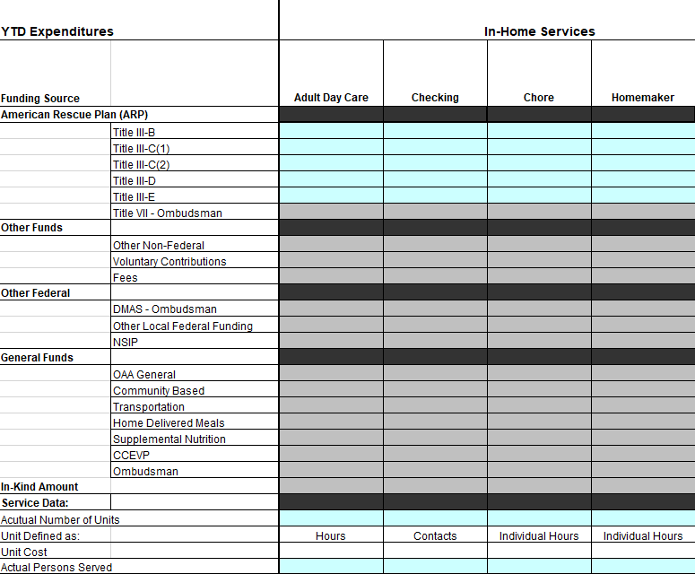
AMR-OC - ARP Units

Slide 29
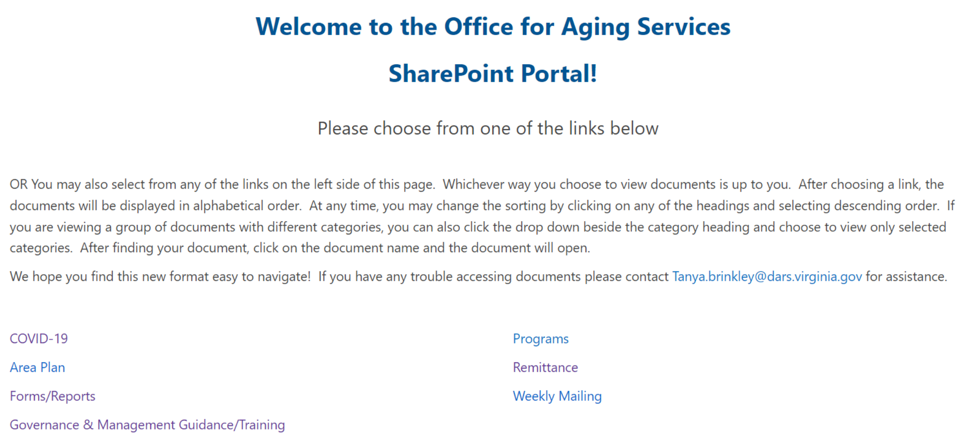
PeerPlace Instructions

Slide 30
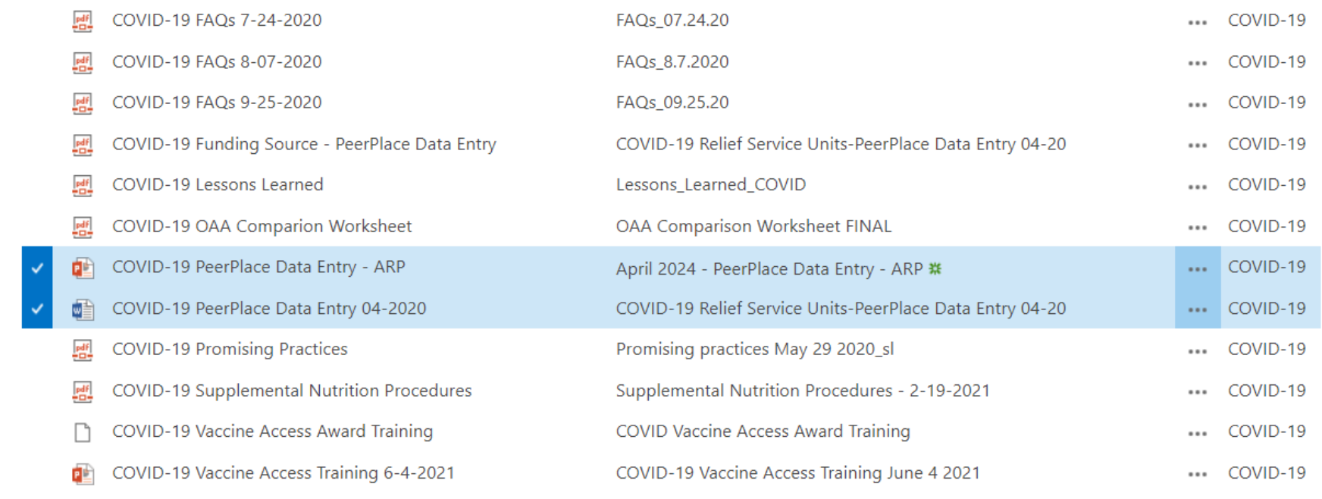
Forms on Providers Portal

Slide 31
Questions?

