Slide 1
Aging Services in Virginia
Department for Aging and Rehabilitative Services
Division for Aging Services

Slide 2
Mission Statement
To improve the employment, quality of life, security, and independence of older Virginians, Virginians with disabilities, and their families.
Notes:
People want to and deserve to live as independently as long as possible. Agencies on Aging provide services to help people live independently.
DARS and the aging network don’t work in a vacuum….but achieve results by partnering with families and communities.

Slide 3
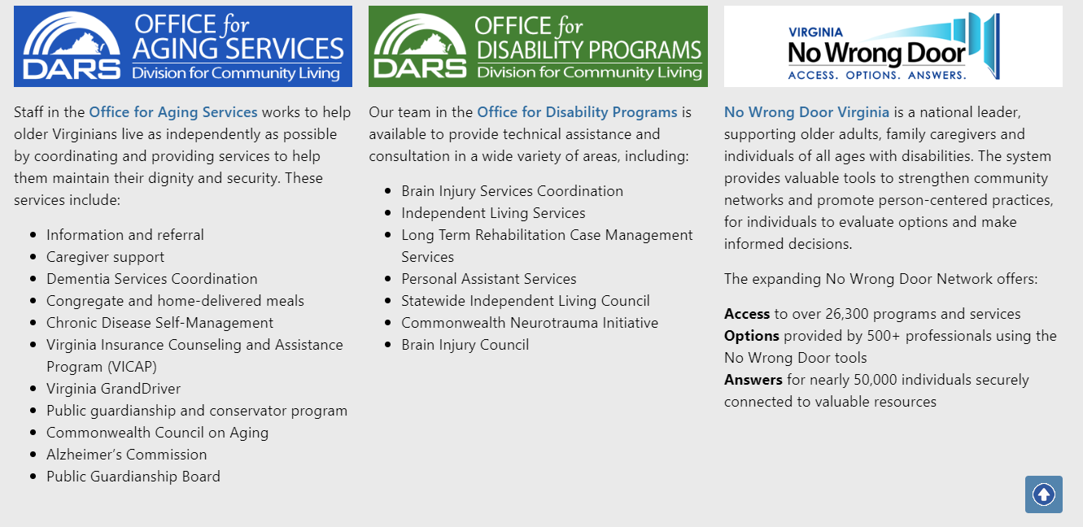
Division for Community Living
Notes:
The Office for Aging Services is now the Division for Aging Services, effective 7/1/2023.
Division for Aging Services: https://vda.virginia.gov

Slide 4
Older Americans Act & Organizational Structure
Notes:
Federal State Local

Slide 5
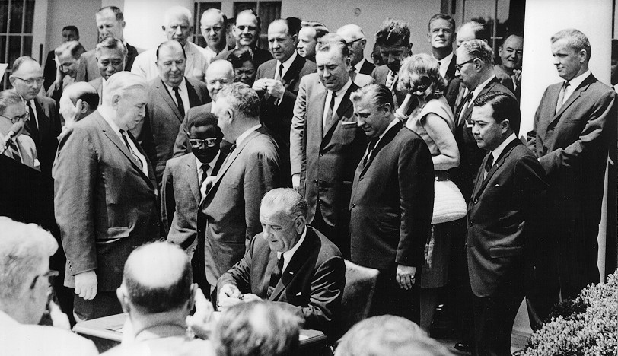
Topics Trends and Issues
Older Americans Act (OAA)
Overview
1965 Great Society Legislation
Establishes the Administration on Aging (AoA), State Units on Aging (SUAs) and Area Agencies on Aging (AAAs)
OAA has be reauthorized 18 times
Federal Mechanism for Aging Grants
Requires DARS and the AAAs to Advocate for Older Individuals
President Johnson signing the OAA in 1965
Notes:
The Older Americans Act was signed into law by President Johnson in July 1965 (54 years ago). Signed just 16 days before President Johnson signed the Social Security Act of 1965 that created Medicare and Medicaid.
The OAA was recently reauthorized in March 2020.
The primary differences between OAA programs and Medicaid and Medicare is that OAA is not an entitlement – so services are only available as funding allows – and it is much, much smaller than either of the other better known programs (Medicaid and Medicare)
1,838,379 Virginians aged 60+

Slide 6
U.S. Department of Health and Human Services
Admin for Community Living/ Administration on Aging
Tribal Grantees
(282)
State Units on Aging (56)
Area Agencies on Aging (618)
Local Service Provider Organizations
CONSUMERS
CONSUMERS
CONSUMERS
Notes:
This slide puts DARS and the AAAs in perspective at the federal level. Most of our funding and direction comes from the federal Administration for Community Living/Administration on Aging.
Describes the national network of State Units on Aging (DARS is one of these) and the Area Agencies on Aging. This structure was created by the OAA.
Virginia has seven federally recognized tribal organizations. The Chickahominy tribe received approval for Title VI federal funding in April, 2020.
AAAs subcontract with thousands of local community-based service providers to deliver meals, provide adult day care, provide transportation, and an array of other services.

Slide 7
Older Americans Act (OAA)
Title III: State and Community Programs
Part A:
Defines the Purpose
Maximize Independence and Dignity
Remove Individual and Social Barriers
Continuum of Care
Managed In-home and Community-Based Services
State Units on Aging (SUAs)
Develop and Administer State Aging Plan
Advocate for Older Individuals
Designate Area Agencies on Aging (AAAs)
Establish Policies, Procedures, Service Standards
Provide Technical Assistance
Area Agencies on Aging (AAAs)
Develop and Administrator Local Aging Plan
Establish Advisory Council
Provide Services
Establish Focal Points to Provide Services
Facilitate Coordination of Community Services
Part B: Support Services & Senior Centers
Community-Based Services and In-Home Services: adult day care, checking (reassuring contact), chore, homemaker, personal care, residential repair and renovation.
Access Services: care coordination, information and assistance, transportation.
Part C: Nutrition / Meals
Subpart 1: Congregate (Group)
Subpart 2: Home Delivered
Part D: Disease Prevention and Health Promotion
Part E: National Family Caregiver Support Program
Notes:
It is Title III that funds a large proportion of the AAA activities.
Priority Services: in-home, access [I & A (CRIA), care coordination (case management), outreach and transportation]; congregate and HDM, nutrition counseling; and legal services:
(A) services associated with access to services (transportation, health services (including mental health services) outreach, information and assistance, (which may include information and assistance to consumers on availability of services under part B and how to receive benefits under and participate in publicly supported programs for which the consumer may be eligible) and case management services);
(B) in-home services, including supportive services for families of older individuals who are victims of Alzheimer’s disease and related disorders with neurological and organic brain dysfunction; and
(C) legal assistance; and assurances that the area agency on aging will report annually to the State agency in detail the amount of funds expended for each such category during the fiscal year most recently concluded;

Slide 8
Topics Trends and Issues
Older Americans Act (OAA)
Title IV: Activities for Health, Independence and Longevity
Demonstration Grants / Programs
Aging & Disability Resource Center Grants
Alzheimer's Disease Grants
Evidence Based Programs (Chronic Disease Self-Management Program)
Title V: Community Service Senior Opportunities Act
Older American Community Service Employment Program
States
National Contractors
Title VI: Grants for Native Americans
Federally recognized American Indian Tribes
Native Hawaiian Program
Title VII: Vulnerable Elder Rights Protection Activities
Ombudsman
Elder Abuse, Neglect and Exploitation
State Legal Assistance Development
Notes:
Title VIII: Tom Osborne Federal Youth Coordination Act

Slide 9
Area Agencies on Aging (AAAs)
Notes:
Primary provider for most services.

Slide 10
Topics Trends and Issues
Area Agencies on Aging (AAAs)
In Virginia 25 local agencies;
Designated by DARS in cooperation with local governments;
Required to have an Advisory Council;
Funding comes from Older Americans Act, state General Fund, local governments, private grants, voluntary contributions, and fees (cost sharing);
Each prepares an Area Plan for Aging Services. This plan becomes the bases for the contract with DARS
Notes:
Services fall into 5 broad categories:
Information and referral (health insurance counseling, client assessment, care coordination, transportation, caregiver support);
Community-based (senior centers, congregate meal sites, adult day care);
In-home (home delivered meals, homemaker, personal care, respite);
Housing (home repair and renovation); and
Elder rights (legal assistance, elder abuse prevention).

Slide 11
Topics Trends and Issues
Virginia’s 25 Agencies on Aging
1 Mountain Empire Older Citizens
2 Appalachian Agency for Senior Citizens
3 District Three Senior Services
4 New River Valley Agency on Aging
5 LOA Area Agency on Aging
6 Valley Program for Aging Services
7 Seniors First (Shenandoah AAA)
8A Alexandria Division of Aging and Adult Services
8B Arlington Agency on Aging
8C Fairfax AAA
8D Loudoun County AAA
8E Prince William AAA
9 Rappahannock-Rapidan
Community Services Board and AAA
10 Jefferson Area Board for Aging
Central VA Alliance for Community Living
Southern AAA
13 Lake Country AAA
14 Piedmont Senior Resources AAA
15 Senior Connections, The Capital AAA
16 Healthy Generations (Rappahannock AAA)
17/18 Bay Aging
19 Crater District AAA
20 Senior Services of Southeastern Virginia
21 Peninsula Agency on Aging
22 Eastern Shore AAA - Community Action Agency
8D
8A
7
8B
8E
8C
9
6
10
16
17/18
22
5
11
15
14
21
2
4
12
19
1
3
20
13
Notes:
Virginia has 25 Area Agencies on Aging.

Slide 12
Virginia’s 25 Agencies on Aging
By Organizational Structure
(14) Private, nonprofit
(5) Joint-exercise-of-powers
8D
8A
(5) Northern VA local Government
7
8B
8E
8C
(1) Community Services Board
9
6
10
16
22
17/18
5
11
15
2
14
21
4
19
3
12
20
1
13
Notes:
Each AAA can be described as fitting one of the four types of organizational structures. They are private, nonstock, nonprofit corporations; joint exercise of power, part of a government unit, or a community service board.
The organizational structure has minimal impact on how DARS works with the agencies. Some of the biggest concerns about organizational structure include:
The Northern Virginia local governmental structure:
Maybe less prone to voluntary donations, but the resources of the local government more than make up difference.
Most of the agency’s financial transactions are handled centrally by the government.
The governing board is the County or City Boards of Supervisors.
The Community Service Board structure:
It is a division within the larger agency.
Private, nonprofits and Joint-Exercise-Of-Powers have very similar structure.
The Older Americans Act (OAA) requires AAAs to have an Advisory Board. The OAA is silent on Governing Board.
Fourteen AAAs are private, nonstock, nonprofit, 501(c)3 corporations with a governing board that makes decisions about services and programs within the parameters of the Older Americans Act. The AAAs are numbered according to the state Planning and Services Area (PSA).
1 - Mountain Empire Older Citizens, Inc.
2 - Appalachian Agency for Senior Citizens, Inc.
5 - LOA – Local Office on Aging, Inc.
6 - Valley Program for Aging Services, Inc.
7 – Seniors First (Shenandoah Area Agency on Aging, Inc.)
11- Central VA Alliance for Community Living
12 - Southern Area Agency on Aging, Inc.
14 - Piedmont Senior Resources Area Agency on Aging, Inc.
15 – Senior Connections, the Capital Area Agency on Aging, Inc.
16 – Healthy Generations (Rappahannock Area Agency on Aging, Inc.)
17/18 - Bay Aging
20 - Senior Services of Southeastern Virginia
21 - Peninsula Agency on Aging, Inc.
22 - Eastern Shore Area Agency on Aging Community Action Agency, Inc.
Five AAAs are Joint Exercise of Powers. §15.2-1300 of the Code of Virginia defines a joint exercise of powers as an agreement for the creation of a governing board, commission, authority or body empowered to have and exercise, on behalf of the several political subdivisions…the powers, rights and authority conferred. In the case of AAAs, a joint exercise of powers is the legal entity (not a state entity or nonprofit) created by an agreement of the localities to provide services to the elderly. Typically each County Supervisor, City or Town Manager of the localities appoints representation to the agency’s governing board.
3 - District Three Senior Services
4 - New River Valley Agency on Aging
10 - Jefferson Area Board for Aging
13 - Lake Country Area Agency on Aging
19 - Crater District Area Agency on Aging
The five Northern AAAs are each a branch of their county or city government.
8A - Alexandria Office of Aging and Adult Services: Located within Community and Human Services. Note: AAA includes adults with disabilities and APS.
8B - Arlington Agency on Aging: Located within Human Services. Note: AAA includes adults with disabilities.
8C - Fairfax Area Agency on Aging (which serves Falls Church, Fairfax City and Fairfax County) Located within Department of Family Services. Note: AAA includes APS.
8D - Loudoun County Area Agency on Aging: Located within Department of Parks, Recreation & Community Services. The Department of Family Services is a separate division.
8E - Prince William Area Agency on Aging (which serves Manassas, Manassas Park and Prince William). The agency reports directly to the County Executive.
The AAA serving planning and service area 9 (Culpeper) Rappahannock-Rapidan Community Services Board and Area Agency on Aging is operated by the local Community Services Board (CSB). The §37.2-500 of the Code of Virginia requires the Department of Behavioral Health and Developmental Services to ensure statewide coverage of CSBs. They appear to be created similar to a Joint Exercise of Powers.
Two AAAs are Community Action Agencies:
Eastern Shore Area Agency on Aging/Community Action Agency, Inc.
Bay Aging, Inc.
The AAA in planning and service area 17 & 18 is Bay Aging and it serves 2 planning and service areas.
Nationally 67% of the AAAs are Government and 33% Private Non-Profit.

Slide 13
Community Assessment
Community Assessment Survey of Older Adults (CASOA) – 17 topics of livability within 6 domains
8,843 completed surveys (10% response rate)
79% rated overall QOL as excellent or good
76% plan to retire in their community
69% gave positive scores to their communities as places to retire

Slide 14
Community Assessment
45% reported housing needs
24% reported mobility needs
30% reported financial challenges
19% reported employment needs

Slide 15
In-Home Services & Home Modifications
Respondents in lower income brackets were more likely than those with higher incomes to report that they would like to move but don't have the resources to do so, or that they want to stay in their current home but are concerned they won't be able to.
?
Notes:
Just over half of older adult survey respondents (54%) indicated that they intended to stay in their homes and 21% would move to a new area or new home in their current area.
Almost 2 in 10 (or 18%) reported that they wanted to stay in their home but were concerned they would not manage to, and 8% said they wanted to move but did not have the resources.
In the same survey, those in lower income brackets were more likely than those with higher incomes to report that they would like to move but don't have the resources to do so, or that they want to stay in their current home but are concerned they won't be able to.

Slide 16
Among older Virginians with concerns about aging in place in their current home, the top concerns are:
%
?
Notes:
Of those older Virginians indicating concerns about the ability to age in place in their current homes, financial reasons (52%) and health reasons (44%) were identified as the top concerns in the older adult survey. The third top concern was that the home was not suited for aging in place (27%).

Slide 17
41% stated they needed chore services
22% of older Virginians stated they had a major or moderate need for homemaker services
6% stated they needed personal care services

Slide 18
Home Modifications
37% of older Virginians indicated a major or moderate need for home repairs or home maintenance assistance
18% needed assistance with maintaining the minimum housing standards
18% needed minor home modifications
16% needed major home modifications

Slide 19
Topics Trends and Issues
OAA Eligibility for Services
Age 60 and over (except Title III-E Grandparents and Title V is 55)
Not an entitlement (guaranteed access to benefits) like Social Security, Medicare or Medicaid
Services can be curtailed due to lack of funding
Self-declaration of income – Not means tested. There is no verification of ability to pay, but programs target poverty
Income information may be asked to determine fee-for-service/cost sharing

Slide 20
Programs & Services
Notes:
Primary provider for most services.

Slide 21
Topics Trends and Issues
Different AAA Provide Different Services
16 Adult Day Care
16 Care Coordination
8 Care Transitions
8 Checking (Reassurance)
7 Chore
25 Congregate (Group) Nutrition
25 Disease Prevention
25 Elder Abuse Prevent./Ombudsman
17 Emergency
25 Home Delivered Nutrition
18 Homemaker
25 Information & Referral/Assistance
25 Legal Assistance
2 Medication Management
4 Money Management
25 Nutrition Education
25 Nutrition Counseling
20 Options Counseling
15 Personal Care
23 Public Information /Education
12 Residential Repair & Renovation
8 Respite Care Initiative
14 Socialization & Recreation
25 Transportation (curb to curb)
4 Assisted Transportation (thru door)
24 Virginia Insurance Counseling & Assistance Program (VICAP)
9 Volunteer
Source: FY’23 Area Plans & VICAP Contract
Notes:
Services in blue are required.

Slide 22
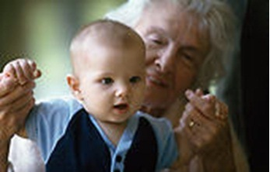
The Typical AAA Client Receiving
An In-Home Service
Three out of four are female
Average age is 80
Half are below poverty line
Half live alone
Has difficulty with 2 – 5 Activities of Daily Living (bathing, eating, toileting, transferring, or dressing)
Receives a home delivered meal
Notes:
Many are Nursing Home eligible
The most common Home and Community Based Service is home delivered meals.

Slide 23
Caregiving
The Average Caregiver
43 years
Female: 55%
Age 50 or older: 36%
Employed: 77%
Over $7,000 Average annual out-of-pocket expense for caregiving
80% provide transportation related help
71% assist with shopping, finances, or housework
60% prepare meals
46% give medicines, pills, or injections
34% aid with mobility in and out of beds and chairs
29% supervise caregiving services
23% help with activities of daily living (ADLs) such as toileting, dressing, and bathing
Notes:
This slide is from The National Family Caregivers Association & Family Caregiver Alliance. The AAAs also provide services to support family caregivers.
1 in 5 adults is a caregiver; 1 in 6 spend over 40 hours/week caregiving.

Slide 24
Senior Community Service and Employment Program (SCSEP)
Eligibility
55 or older (no upper limit)
At or below 125% of the Federal Poverty Level for family size
Residents of the county or city that is served
Unemployed
Sponsors in Virginia
DARS
AARP
Goodwill
National Council on Aging

Slide 25
Falls Prevention Grant
Matter of Balance evidence-based program
Goal is to reduce the fear of falling and increase activity levels
8 sessions
Taught by volunteer lay leaders /coaches trained by Master Trainers
Bingocize®
Participants play Bingocize® for one hour 2 times per
week for 10 weeks
Notes:
Both programs can be provided virtually.

Slide 26
Chronic Disease Self Management
Series of 6 week workshops conducted by trained leaders in senior centers, meal sites, and other community locations to teach self-management skills.
Over 13,000 individuals with chronic conditions have completed workshops.
Saving health care dollars by improving quality of life and decreasing hospital utilization.
Notes:
Over 13,000 people have participated in a CDSME program, 61% of whom have more than one chronic condition.

Slide 27
Virginia Lifespan Respite Voucher Program
You must be a Virginia caregiver of a child or children, or an adult or adults, who reside at least part-time in your household.
You may receive up to $595 in vouchers per family. The primary caregiver for the person receiving care must apply for the funds.
You may be eligible, but funds are limited. Not everyone who applies will be approved.
Special emphasis on caregivers of individuals with dementia, grandparents raising grandchildren, male caregivers, rural caregivers, and LGBTQ+ caregivers.
Notes:
Through the 3 previous lifespan respite grants, DARS provided respite reimbursements to 1,138 families. A significant majority of vouchers were used by caregivers of children with autism or ID.
In the current grant, we hope to serve up to 1000 families.

Slide 28
Virginia Insurance Counseling and Assistance Program
Certified staff & volunteers function as Insurance Counselors
Assist Medicare Beneficiaries in understanding Medicare Part A, Part B and Part D, Low Income Subsidy for Part D, Medicare Advantage Plans, Medigap policies, Medicaid (Commonwealth Coordinated Care), as well as Long-Term Care Insurance and medical bills.
Counseling services are free.
Notes:
DARS administers the VICAP program through 24 of the 25 AAAs. This program offers free, unbiased insurance counseling for Medicare beneficiaries to help them choose the best Medicare plan to meet their needs. The Department has a toll-free number to receive questions about aging services across the state. Most of the calls are about Medicare/Medicaid health plan issues.

Slide 29
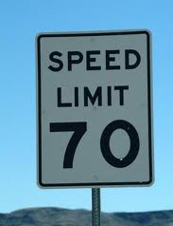
Virginia GrandDriver
First program in Nation – Grant in partnership with DMV
An education and awareness campaign on the effects of aging on driving ability and to encourage drivers to make appropriate decisions.
www.granddriver.net
Recognizing the Signs of Senior Driving Difficulty
Staying safe tips for drivers
Self-Assessment Tools
Publications, brochures and pamphlets for senior drivers and their caregivers
“CarFit” events
Driver assessment/testing centers
In Virginia,
70 is a speed limit,
not an age limit.
Notes:
Virginia was the first state to implement the program in 2004.
Paid through the National Highway Traffic Safety Administration (NHTSA)
Virginia’s GrandDriver campaign urges the public - particularly drivers over 65 and their adult children - to learn more about the effects of aging on driving ability and to encourage dialogue. The campaign provides information on the warning signs that may indicate that age has affected a person’s ability to drive. It also offers information on adaptations that can help an older driver continue to drive safely, as well as resources for those who may need additional assistance.

Slide 30
Senior Farmers' Market Nutrition Program (SFMNP)
During the 2022 market season, Virginia’s Farm Market Fresh for Seniors program:
helped 10,950 eligible seniors get fresh, tasty, and nutritious locally-grown fruit, vegetables, and cut herbs.
supported 192 local farmers and farmers’ markets.
DARS partners with the Virginia Department of Agriculture and Consumer Services (VDACS), 11 local AAAs and 1 city government to operate the program which is funded by the U.S. Department of Agriculture, Food and Nutrition Service.
Notes:
Last year, DARS received some state funding to help expand the program statewide. DARS also received ARPA funds that will help with this expansion and promote the transition to electronic vouchers.. 22 AAAs , 2 cities and one county government are now participating in the 2023 growing season.

Slide 31
Senior Farmers' Market Nutrition Program (SFMNP)
During the 2023 market season, Virginia’s Farm Market Fresh for Seniors program:
distributed 26,400 $50 booklets to eligible seniors for locally-grown fruit, vegetables, and cut herbs.
supported 279 local farmers and farmers’ markets.
DARS partners with the VDACS, VSU and VAFMA, 21 local AAAs and 3 cities, 1 county and 1 non-profit to operate the program which is funded by the USDA and state funds.
Notes:
Last year, DARS received some state funding to help expand the program statewide. DARS also received ARPA funds that will help with this expansion and promote the transition to electronic vouchers.. 22 AAAs , 2 cities and one county government are now participating in the 2023 growing season.

Slide 32
Senior Cool Care
Sponsored by Dominion Energy
Administered by DARS through local AAAs
Provides portable and room air conditioners or fans to:
Seniors age 60 and older
At or below poverty level
Needing additional cooling at home

Slide 33
Dementia services
Dementia Care Coordination
Funded at $262,500 per year through DARS
Using the evidence-based Benjamin Rose Institute Care Consultation program
Capacity for 50 families (1 FTE)
Housed at University of Virginia’s Memory Disorders Clinic
Partnering with Alzheimer’s Association
Dealing with Dementia workshops for caregivers
Offered in several areas of Virginia
Dementia Friendly Community Initiatives & Dementia Friends
Notes:
Most state funding for dementia services falls under Medicaid support for long-term care and supporting people with a primary diagnosis of Alzheimer’s or another form of dementia in the state psychiatric hospital system. Additionally, there is the Alzheimer’s and Related Disorders Research Award Fund which supports research and is administered by the Virginia Center on Aging housed at Virginia Commonwealth University.

Slide 34
Dementia Capable Virginia
New webpage containing all DCV materials and more:
Expanded resources and links
Dementia Road Map
Dementia Safety Information Toolkit
Dementia Fact Sheets
Primary Care Dementia Toolkit
Training modules
Primary Care microlearning modules
Person-Centered Dementia Capable training modules for Area Agency on Aging staff
APS staff microlearning module (under development)
Listing of memory assessment centers serving Virginians
Dementia Friendly initiatives

Slide 35
Public Guardian and Conservator Program
Who qualifies:
Cannot care for themselves physically and emotionally – incapacitated
Does not have any financial resources – indigent
No willing and responsible relative or
friend
What a guardian or conservator does:
Legally acts in the person’s behalf
Determines individual’s appropriate care and placement
(can include health care, management of finances, living arrangements and even end-of-life decisions)
Seeks eligibility for public assistance
Notes:
Guardianship is a serious step and should be used only where there are no less-restrictive alternatives. It is used to take care of highly vulnerable individuals.
Prior to 1999, the sheriff in each locality served as the guardian.
Currently:
1349 slots
12 providers, including 4 AAAs (MEOC, AASC, District Three, and Senior Connections) and 1 CSB
Program Notes:
Low staff/person ratio; best practices based (1:20)
On-call 24/7
History
1993: Virginia Guardianship Association approached General Assembly
1995: Appropriation for model start-up funds to replace sheriffs as guardians of last resort
1997: Established by law in §§2.2-711 et seq., VA Code
Karen A. Roberto, Joy O. Duke, Nancy Brossoie, Pamela Teaster, The Need for Public Guardians in the Commonwealth of Virginia, Center of Gerontology, Virginia Polytechnic Institute and State University, May 2007

Slide 36
