Slide 1
PeerPlace Data Entry – CRIA2
ARP funded services may be documented and tracked in the CRIA2 program
The following enhancements have been made to the CRIA2 program:
Units Entry was been updated to allow ARP service units tracking in the CRIA2 program:
ARP Service Types were added to the CRIA2 program on September 30, 2021 and can be identified in your list as any service type beginning with the prefix of “ARP”
AAAs were emailed the full list of ARP services available and provided with instructions for how to contact the NWD Helpdesk if the agency would prefer to track ARP service(s) in programs other than CRIA2
The NWD Helpdesk can be contacted at NWDHelp@dars.virginia.gov or through online ticket within the PeerPlace system under Support / Helpdesk Tickets
Notes:
Speaker Notes:

Slide 2
PeerPlace Data Entry – CRIA2
ARP Service Types:
ARP Adult Day Care | ARP CG Other Respite | ARP Home Delivered Meals
ARP Asst Tech DME PERS Devices | ARP CG Other Supplemental | ARP Homemaker
ARP Asst Tech DME PERS Payments | ARP CG Support Groups | ARP Incentive Program
ARP Asst Transportation | ARP Checking | ARP Medication Management
ARP Care Coordination | ARP Chore | ARP Money Management
ARP Care Transitions | ARP Congregate Meals | ARP Nutrition Counseling
ARP CDSME | ARP Consumable Supplies | ARP Nutrition Education
ARP CG Caregiver Training | ARP CRIA | ARP Options Counseling
ARP CG Direct Payments | ARP Disease Prevention | ARP Personal Care
ARP CG Direct Payments Respite | ARP Emergency | ARP Residential Repair Renovation
ARP CG Financial Consultation | ARP Employment | ARP Socialization Recreation
ARP CG Individual Counseling | ARP Falls Prevention | ARP Transportation
ARP CG Institutional Respite | ARP Health Education Screening | ARP Volunteer
Notes:
Speaker Notes:

Slide 3
PeerPlace Data Entry – CRIA2
CRIA2 / Units Entry – Overview
For Encounters where ARP Services will be tracked, use the Units Entry screen within the CRIA Encounter to enter and track service units
Notes:
Speaker Notes:

Slide 4
PeerPlace Data Entry – CRIA2
CRIA2 / Units Entry – Edit existing unit
Click Units Entry link in the CRIA Encounter to
Click on the Service Date link of the existing unit where the Service Type is Standard CRIA Contact
Notes:
Speaker Notes:

Slide 5
PeerPlace Data Entry – CRIA2
CRIA2 / Units Entry – Edit existing unit
After having clicked on the Service Date link of the row where the Standard CRIA Contact is listed, the Units Entry data entry screen will come up
Click Edit and make the following changes:
Change Service Type from Standard CRIA Contact to A service type beginning with “ARP”
Change Funding Source from Title III-B to “ARP” or AAA preferred value
Click Save & Exit when edits are complete
Notes:
Speaker Notes:

Slide 6
PeerPlace Data Entry – CRIA2
CRIA2 / Units Entry – Add New units part 1
Click Units Entry in the CRIA Encounter
Click the New button to add more service units for ARP Services
Notes:
Speaker Notes:

Slide 7
PeerPlace Data Entry – CRIA2
CRIA2 / Units Entry – Add New units part 2
1. Enter a Service Date to match the date on which the actual service took place (will default to today's date)
2. Select appropriate Service Type for service
3. Select yourself as the Author
4. Select appropriate Unit Type for service
5. Enter total units for date of service in the Service Units (will default to 1)
6. Select ARP or AAA preferred value as Funding Source
7. Click Save & Exit when finished (Click Save & New to continue entering additional units)
Notes:
Speaker Notes:

Slide 8
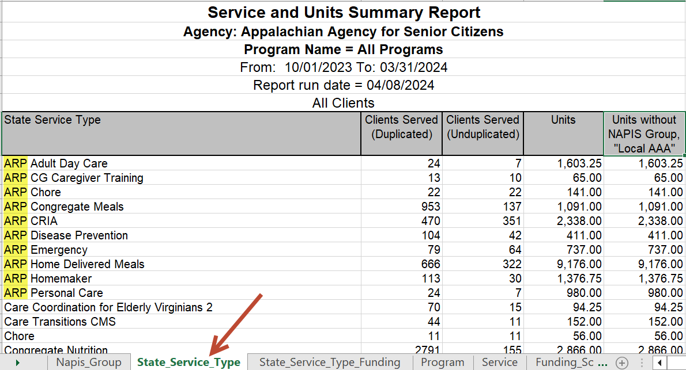
PeerPlace Data Entry – CRIA2
Service and Units Summary Report
Run the Service and Units Summary Report (or Service and Units Summary Report Subcontractors if linked sub-contracted agencies exist in PeerPlace which enter units on behalf of the AAA) to see the number of units and unduplicated individuals to enter on the AMR OC
Use the tab named State_Service_Type to locate the “ARP” services units information where rows starts with “ARP” (highlighted below for emphasis)
Notes:
Speaker Notes:

