Slide 1
AAA COVID-19 Response
Network Webinar
Thursday, April 9, 2020
Notes:
Good morning, and thank you for joining the Division for Community Living and AAA COVID-19 Response Network Call. I am ___________at the Department for Aging and Rehabilitative Services. We also have others from DARS DCL team on the call including:
_______________________
The objective of today’s meeting is to provide information:

Slide 2
1:00 pm Welcome, Introductions and Agenda
Marcia DuBois, Deputy Commissioner, DARS
1:05 pm Overview of Response and Support
Kathy Miller, Director of Aging Programs & Services, DARS
1:20 pm Fiscal Guidelines & Reporting
Maurice Talley, Fiscal Manger, DARS
Tanya Brinkley, Fiscal Specialist, DARS
Brenda Cooper, Contract Specialist, DARS
1:40 pm Nutrition Program Guidance
Kelly Wright, Nutrition Program Coordinator, DARS
1:55 pm Data Tracking Overview
Christy Miller, HCBS IT Operations Manager, DARS
2:10 pm Question and Answer
Facilitated Group Discussion
2:25 pm Wrap Up and What’s Next
Marcia DuBois, Deputy Commissioner, DARS
2:30 pm Adjourn
AGENDA

Slide 3
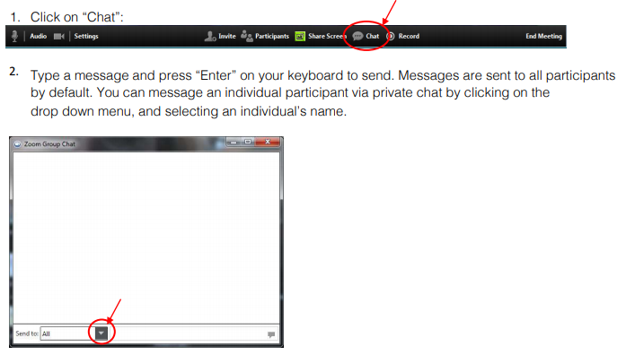
Communication During the Meeting: The Chat Box
Notes:
Before we get started, though, I do have one housekeeping note. Please be aware the session offers a chat feature, which provides you the ability to send instant messages during the call.
You can send private messages to one person, or message all participants, by selecting an individual’s name or selecting “all” in the “send to” dropdown.
Once you select who you are sending the message to, you will type your message into the chat box and hit “enter,” which will send it.
So, if you have a question, please feel free to type it in chat and we will either answer it in real time, or hold onto it to address during the Question and Answer portion of our call.

Slide 4
Overview of Response and Support
Kathy Miller

Slide 5
FAMILIES FIRST CORONAVIRUS RESPONSE ACT (FFCRA)
$80 million for OAA Title III-C1 Nutrition Services
$160 million for OAA Title III-C2
$10 million for Title VI Native American Tribes
Notes:
Since the COVID-19 pandemic began spreading across the country, Congress has passed three packages of legislation to protect public health and stimulate the economy.

Slide 6
FFCRA
Transfers up to 50% are presumptively approved between FFCRA supplemental grants C-1 Congregate Meal Program and C-2 Home Delivered Meal Program
No Service Match required
Match required for Administrative Funds

Slide 7
FFCRA
The Families First Coronavirus Response Act funds have been issued under a separate grant award number;
Therefore, funds must be accounted for separately from the regular issuance of Title III OAA funding.
Notes:
Since the COVID-19 pandemic began spreading across the country, Congress has passed three packages of legislation to protect public health and stimulate the economy.

Slide 8
Coronavirus Aid Relief and Economic Security (CARES) ACT
$200 million for OAA Title III-B Supportive Services
$480 million for OAA Title III-C Nutrition Services
$100 million for Title III-E Family Caregiver Supports
$20 million for Title VI Tribal Nutrition Services
$20 million for Elder Justice Activities, including the Long-Term Care Ombudsman program
$50 million for Aging and Disability Resource Centers

Slide 9
CARES Act
What flexibilities are available in the CARES Act?
Waiver of service match
100% transfer authority between C-1 and C-2
“Home-bound” includes individuals practicing social distancing
Waiver of DRI/DGAs for meals purchased with supplemental funding
These flexibilities apply to funding awarded under the CARES Act (Supplemental #3), the Families First Response Act (Supplemental #2), and regular OAA for the duration of the public health emergency.

Slide 10
Major Disaster Declaration (MDD)
A Major Disaster Declaration (MDD) by the President under the Stafford Act triggers disaster relief authority in the Older Americans Act (OAA).
Once a MDD request by a State is approved, Section 310(c) permits states to use any portion of the funds made available under sections of the Act for disaster relief for older individuals.
In this regard, flexibility is provided for States – without the need for a separate application, transfer request, or request for a waiver -- to use existing allocations already made to them under Title III-B, C1, C2, D and E of the Act for disaster relief.

Slide 11
MDD
States may use any portions of any open OAA grant awards (i.e., FFY 2018, 2019, or 2020) in order to provide disaster relief services.
Any allowable Older Americans Act service provided to an eligible person under the OAA during this COVID-19 emergency is considered a disaster relief service.

Slide 12
MDD
Drive through, take out or home delivered meals
Telephone/virtual well-being checks
Grocery/pharmacy/supply delivery

Slide 13
Fiscal Guidelines & Reporting
Maurice Talley Tanya Brinkley Brenda Cooper

Slide 14
FFCRA
Funds must be accounted for separately from the regular issuance of Title III Older Americans Act funding.
Service Match has been waived
Area Plan Administration is allowed but if taken, match is required at the normal 25% match rate.
100% transfer allowed between C1-C2
Notes:
The Families First Coronavirus Response Act funds have been issued under a separate grant award number; therefore, funds must be accounted for separately from the regular issuance of Title III Older Americans Act funding. At a minimum and where possible, States should be recording the number of clients to whom service is provided, the name or category of services provided, the number of units of service provided, and the expenditures related to providing such services.
A Families First worksheet has been added to the AMR-OC form for you to request payment and track your expenditures, number of units and persons served. You will need to enter the amounts that your agency has been awarded under the Approved Budget Columns and then update your YTD expenditures each month with the number of units and clients served. Columns have been added to the Payment and Request sheet for the new funding as well.

Slide 15
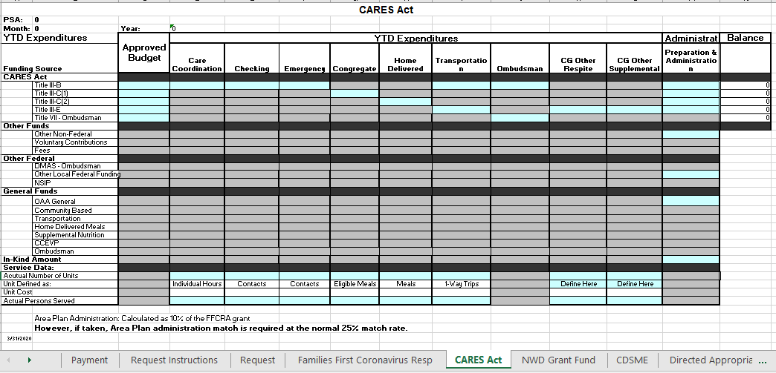
CARES Act
Funds must be accounted for separately from the regular issuance of Title III Older Americans Act funding.
Includes funding for Title III-B, III-C, III-E, and Ombudsman under Title VII
Service Match has been waived
100% transfer allowed between C1-C2
Notes:
The CARES Act funds are also being issued under a separate grant award number; therefore, funds must be accounted for separately from the regular issuance of Title III Older Americans Act funding. As with the Families First funds a worksheet has been added to the AMR-OC form for you to request payment and track your expenditures, number of units and persons served. You will need to enter the amounts that your agency will be awarded under the Approved Budget Columns and then update your YTD expenditures each month with the number of units and clients served. Columns for the CARES Act have also been added to the Payment and Request sheet for this new funding.

Slide 16
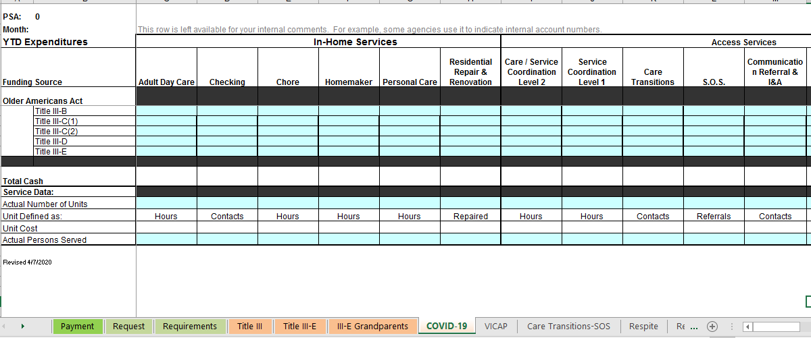
Major Disaster Declaration
No Additional Funding
Flexibility is provided for states – without the need for a separate application, transfer request, or request for a waiver -- to use existing allocations already made to them under Title III-B, C-1, C-2, D, and E for disaster relief.
States do not have to make transfers once the major disaster declaration has been declared. States have the ability to simply designate funds as “disaster relief” and spend them in response to the identified needs.
Reporting of funds reallocated for disaster relief should be identified and reported on the “COVID-19” worksheet.
Notes:
The CARES Act funds are also being issued under a separate grant award number; therefore, funds must be accounted for separately from the regular issuance of Title III Older Americans Act funding. As with the Families First funds a worksheet has been added to the AMR-OC form for you to request payment and track your expenditures, number of units and persons served. You will need to enter the amounts that your agency will be awarded under the Approved Budget Columns and then update your YTD expenditures each month with the number of units and clients served. Columns for the CARES Act have also been added to the Payment and Request sheet for this new funding.
The Major Disaster declaration that has been approved for The Commonwealth of Virginia, permits states to use any portion of the funds made available under any and all sections of the Act for disaster relief for older individuals. In this regard, flexibility is provided for states – without the need for a separate application, transfer request, or request for a waiver -- to use existing allocations already made to them under Title III-B, C-1, C-2, D, and E for disaster relief.
This means that a state may use Title III-B, C-1, C-2, D, and/or E funds for any disaster relief activities for older individuals or family caregivers served under the OAA, which may include, but are not limited to:
providing drive through, take out, or home-delivered meals,
providing well-being checks via phone, in-person, or virtual means, and
providing homemaker, chore, grocery/pharmacy/supply delivery, or other services.
For example, as part of their COVID-19 disaster relief activities, a state may use:
funding originally allocated under Title III-C-1 to provide take out meals and, and
funding originally allocated under Title III-D to conduct daily phone well-being checks.
In this COVID-19 Major Disaster-declared response for the examples above, the state does not need to submit a transfer or waiver request to ACL. However, the state should be prepared to track:
COVID-19 related expenditures using Title III-C-1 funding and number of persons and meals served and
COVID-19 related expenditures using Title III-D funding and number of persons and units served.
To assist with the Major Disaster Declaration, we have added a worksheet to the regular AMR titled COVID-19. This is where you will report all of your COVID-19 expenditures after all of your new funding has been expended. This worksheet is still in the Draft phase but will have the service columns listed with the funding sources that have been permitted to use open so that you can easily expend the funds as needed. This sheet is also where you will record the number of units and persons served for COVID-19 related expenses. There may be future changes to this sheet as we wait for more guidance from ACL.

Slide 17
Because FFCRA & CARES Act funding is specifically appropriated for COVID-19 response, we encourage the use of funding in the following order:
Families First Coronavirus Response Act funding;
CARES Act funding;
“Regular” Title III grant funds, starting with the oldest funds available first.
10% Carryover Limit waived going into FY2021
Notes:
Because FFCRA & CARES Act funding is specifically appropriated for COVID-19 response, we encourage the use of funding in the following order: Families First Coronavirus Response Act funding; CARES Act funding; then “Regular” Title III grant funds, starting with the oldest funds available first. With the additional supplemental funding, we realize that it may be hard to expend all of your regular OAA funding in a timely manner. Because of this, the carryover limit will be waived for any existing 2020 OAA funds going into Area Plan FY2021.

Slide 18
Nutrition Program Guidance
Kelly Wright

Slide 19
COVID-19 Nutrition FAQs
What is the definition of a COVID-19 meal?
Technically, any meal that is served in response to the national Major Disaster Declaration of March 13, 2020 is part of the COVID-19 response. However, because DARS is required to track funding and service units separately, there will be different designations, such as Families First Coronavirus Response Act (FFCRA) meals, CARES Act meals, and COVID-19 (VA Major Disaster) meals.

Slide 20
COVID-19 Nutrition FAQs
Are there changes to nutrition guidelines?
Yes, the CARES Act waives the DRI/DGA requirements of emergency meals during the pandemic.
However, ACL encourages the use of DRI/DGA standards to help older adults maintain their health and manage their chronic conditions and to provide quality service.
ACL encourages programs to provide nutritious meals when available.
At a minimum, no less than 1/3 of the recommended daily caloric intake for an older individual.

Slide 21
COVID-19 Nutrition FAQs
Due to separate funding being given for COVID-19, we want to be sure to accurately record our COVID-19 meals vs non-COVID-19 meals. Please advise.
Use FFCRA first, then the CARES Act next, then the other sources of funds. The AAAs can decide on their AMR from which “buckets” they are seeking reimbursement. This may not necessarily line up with the service units in PeerPlace.

Slide 22
COVID-19 Nutrition FAQs
Are we required to complete pages 1-4 of the UAI for new HDM clients or for CM clients that are switching over to HDM during the pandemic?
Completion of the UAI has been waived; just a VA Quick Form is acceptable. The NSI can be waived during the pandemic, if you do NOT have the work force to complete it with the client.

Slide 23
Survey Says….
72% are lacking in adequate supplies to keep their participants, staff, and volunteers safe while delivering meals.
hand sanitizer, disinfectant wipes, gloves, masks, bleach, and take out containers.
17% concerned their food vendor may not meet the demand, if the crisis extends for a long period of time.

Slide 24
Non-Food and PPE Suppliers
Guest Supply (simplysupplies.com)
Premier Marketing Group (pmginc.biz)
Centricity (centricitynow.com)

Slide 25
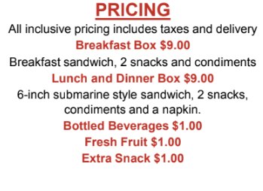
Meal Suppliers
Sysco
1-2 Virginia Facilities, delivered to AAAs
Flash Frozen meals, 2 week supply
No contract; May be ready to start by May 1
PRICING
$7.54/each meal
Emergency Relief Catering Company (www.erccCatering.com)

Slide 26
Meal Suppliers
Local Restaurants
Grocery Stores (i.e. instacart)
tracked under emergency services

Slide 27
Senior Farmers Market Nutrition Program (SFMNP)
10 participating AAAs
Start making Plan B now – DARS will host virtual meeting in coming weeks
Paper coupon booklets have been ordered
Farmers have planted crops
Fresh produce can surely enhance the meals seniors receive

Slide 28
Data Tracking and Overview
Christy Miller

Slide 29
FFCRA & CARES Act Service Types
CARES Act Home Delivered Meals
CARES Act Congregate Meals
CARES Act Transportation
Families First Home Delivered Meals
Families First Congregate Meals
Notes:
To assist you with utilizing the CARES Act and Families First aid, new Service Types have been setup for your agency in the programs where you normally track Home Delivered Meals, Congregate Meals, Transportation as well as in your CRIA2 program.
These new Service Types were setup for tracking services supported by the CARES Act and Families First. The Service Types setup in your traditional meals and transportation programs are named:
CARES Act Home Delivered Meals
CARES Act Congregate Meals
CARES Act Transportation
Families First Home Delivered Meals
Families First Congregate Meals
You will need to establish new Event Profiles for these new Service Types and add the individuals receiving meals under the CARES Act and / or Families First to those new Events and enter units into those new Events the same way you already do for your existing meals services each month.

Slide 30
CRIA 2 Program Service Types
CARES Act Emergency
CARES Act Checking
CARES Act Care Coordination
CARES Act CG Other Supplemental
CARES Act CG Other Respite
CARES Act Transportation
CARES Act Home Delivered Meals
CARES Act Congregate Meals
Families First Home Delivered Meals
Families First Congregate Meals
Notes:
These service types have also been established in your CRIA2 program along with other services that can be tracked using the CRIA2 Units Entry screen. These services have been setup in your CRIA2 program to allow for an expedited method of units entry without the need for program enrollment. The services are named:
CARES Act Emergency
CARES Act Checking
CARES Act Care Coordination
CARES Act CG Other Supplemental
CARES Act CG Other Respite
CARES Act Transportation
CARES Act Home Delivered Meals
CARES Act Congregate Meals
Families First Home Delivered Meals
Families First Congregate Meals

Slide 31
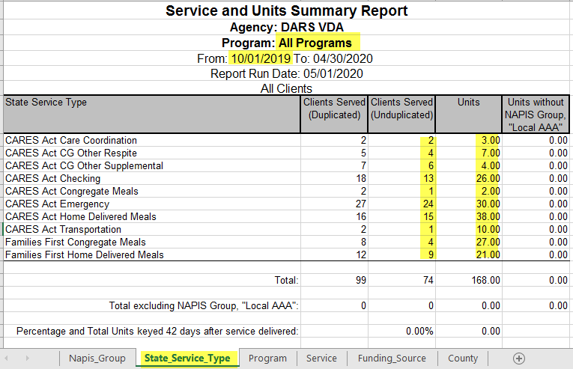
Notes:
Regardless of where the units for these new services are tracked, the units and individuals served will not show up on the ‘AAA Service Summary’ (or ‘AAA Service Summary Sub-Contractors’ for those with linked sub-contractors) reports. This is because they are to be kept separated from your standard units counts. For that reason, use the ‘Service Units and Summary Report’ and run the report for ‘All Programs’ and use the same date span as you would for the ‘AAA Service Summary’ report. Once the report has completed, download it and look at the ‘State Service Type’ tab. Locate the rows matching the services named above and use the columns named ‘Client Served (Unduplicated)’ and ‘Units’ for your AMR reporting.
These numbers are to be entered on the newly revised AMR OC in the corresponding location for the service.

Slide 32
Questions regarding PeerPlace usage for this process are to be directed to the helpdesk at:
NWDHelp@dars.virginia.gov

Slide 33
Question and Answer
Facilitated Group Discussion

Slide 34
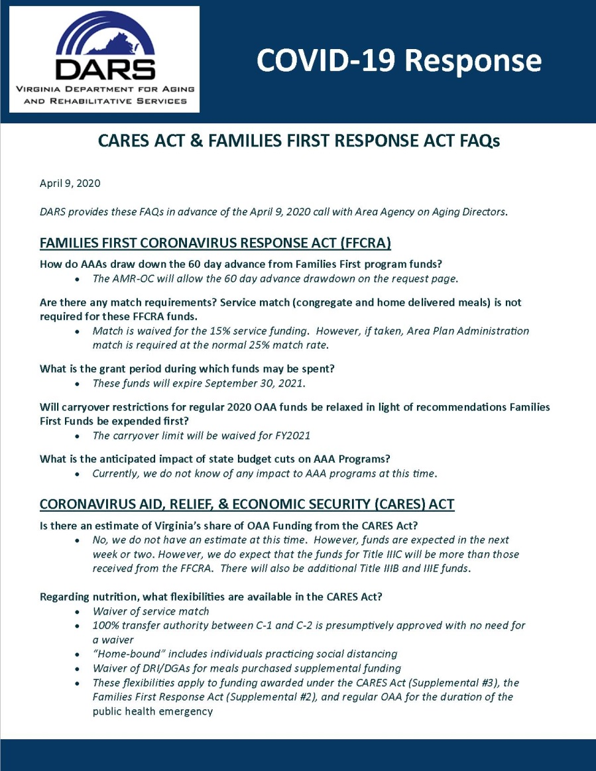
FAQs

Slide 35
Wrap Up and What’s Next
Marcia DuBois

Slide 36
Questions should be directed to Kathy Miller
Kathy.Miller@dars.virginia.gov

Slide 37
Adjourn

