Slide 1
AAA COVID-19 Response
Special Topic: Data Entry and Reporting
Friday, May 15, 2020

Slide 2
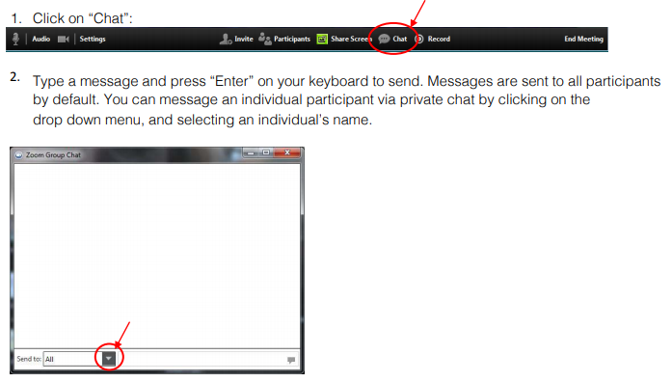
Communication During the Meeting: The Chat Box

Slide 3
FAMILIES FIRST CORONAVIRUS RESPONSE ACT (FFCRA) – will be referred to as “Families First”
Coronavirus Aid Relief and Economic Security (CARES) ACT – will be referred to as “CARES Act”
Both the CARES Act and Families First Act funds have been issued under separate grant awards
Therefore, funds as well as service units and individuals served must be accounted for separately from the regular issuance of Title III OAA funding

Slide 4
Major Disaster Declaration (MDD) – will be referred to as “Disaster Declaration”
Flexibility is provided for States – without the need for a separate application, transfer request, or request for a waiver -- to use existing allocations already made to them under Title III-B, C1, C2, D and E of the Act for disaster relief
Therefore, service units and individuals served are to be included in and accounted for within the total regular issuance of Title III OAA funding
Service units must be ‘flagged’ for Disaster Declaration in order to see a how many of the total units were identified for Disaster Declaration flexibility

Slide 5
In Summary
Service units and individuals served using ‘Families First’ must be entered separately and reported separately from other units entry
Service units and individuals served using ‘CARES Act’ must be entered separately and reported separately from other units entry
Service units and individuals served where the flexibility under the Disaster Declaration is utilized, are not to be separated from other units but must be ‘flagged’ in order to see what portion of the grand total of service units was under Disaster Declaration flexibility

Slide 6
Data Entry Families First and CARES Act
Service units and individuals served using Families First must be entered using the new Families First Service Types and ‘Families First’ as ‘Funding Source’
Service units and individuals served using CARES Act must be entered using the new CARES Act Service Types and ‘CARES Act’ as ‘Funding Source’
Funding Sources of ‘Families First’ and ‘CARES Act’ are only to be used in conjunction with the new Families First and CARES Act Service Types

Slide 7
New Families First and CARES Act Service Types
New Service Types for Families First and CARES Act have been setup at each agency in CRIA2 and in the programs where Home Delivered Meals, Congregate Meals and Transportation are normally tracked
If any of these Service Types for Families First and / or CARES Act are needed in additional programs, contact the NWD Help Desk at NWDHelp@DARS.Virginia.gov and that request can be accommodated
New Event Profiles for these new Service Types must be created in programs where units are to be entered and tracked before entering service units unless entering the service units on a person by person basis (within enrollment) or in CRIA2

Slide 8
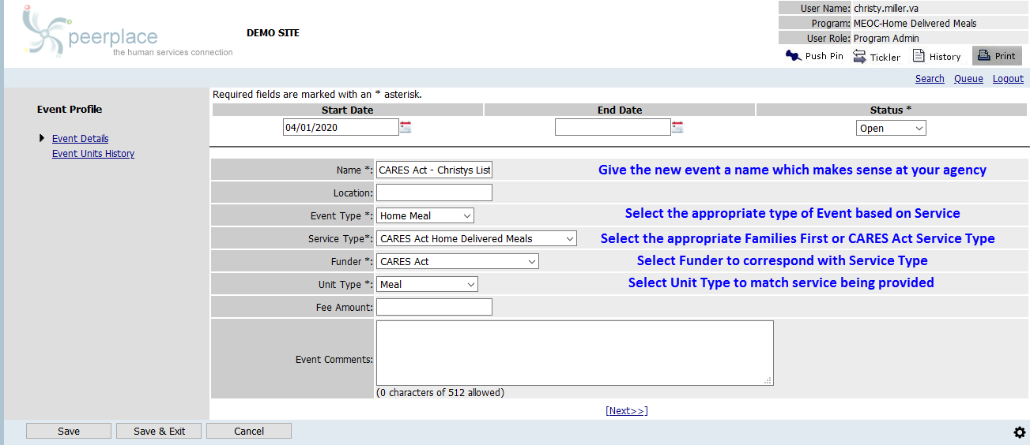
SAMPLE: New Event Profile

Slide 9
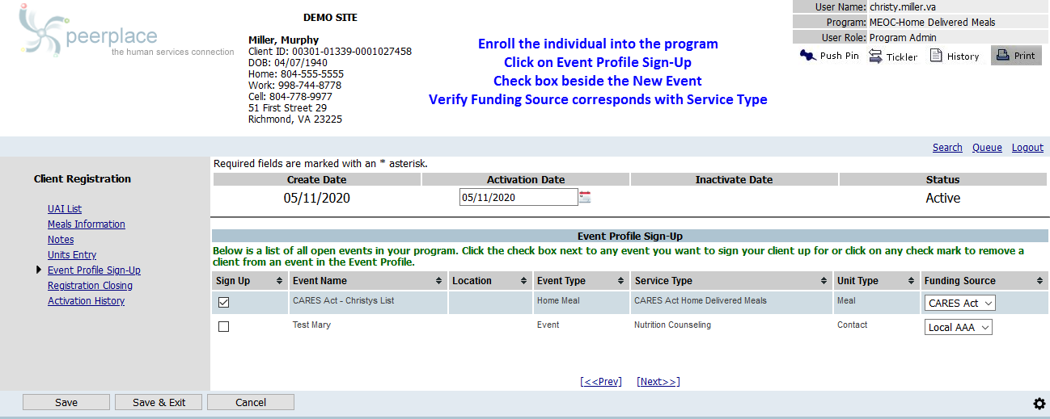
SAMPLE: Sign Up Individual to Event

Slide 10
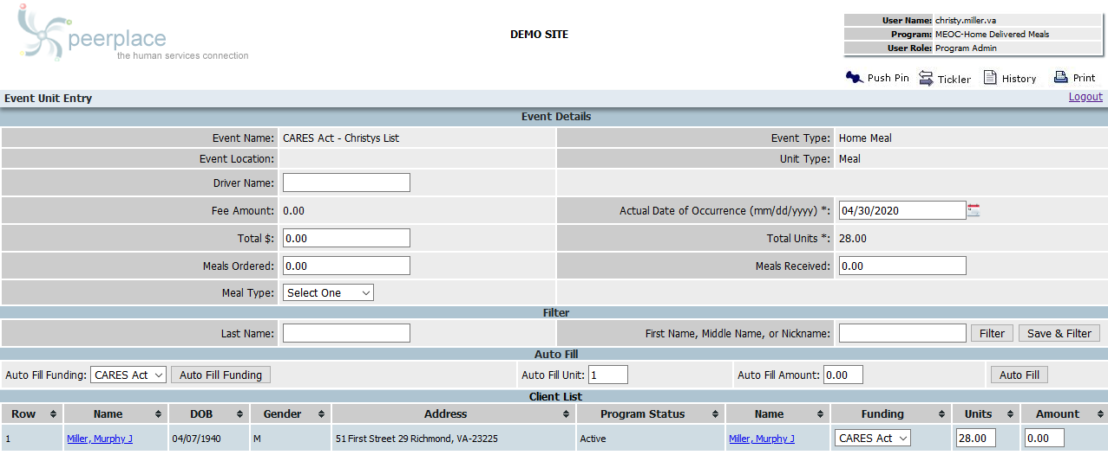
SAMPLE: Enter Units into Event

Slide 11
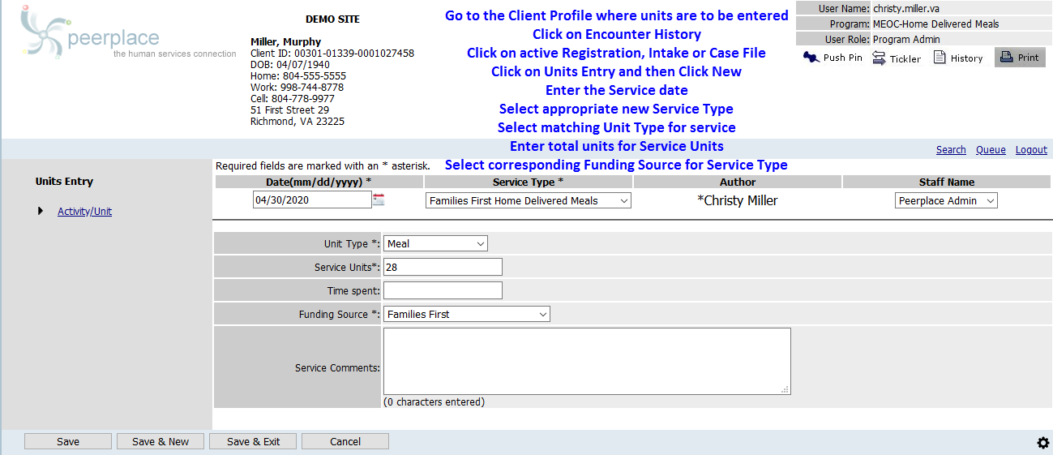
SAMPLE: Enter Units Person by Person

Slide 12
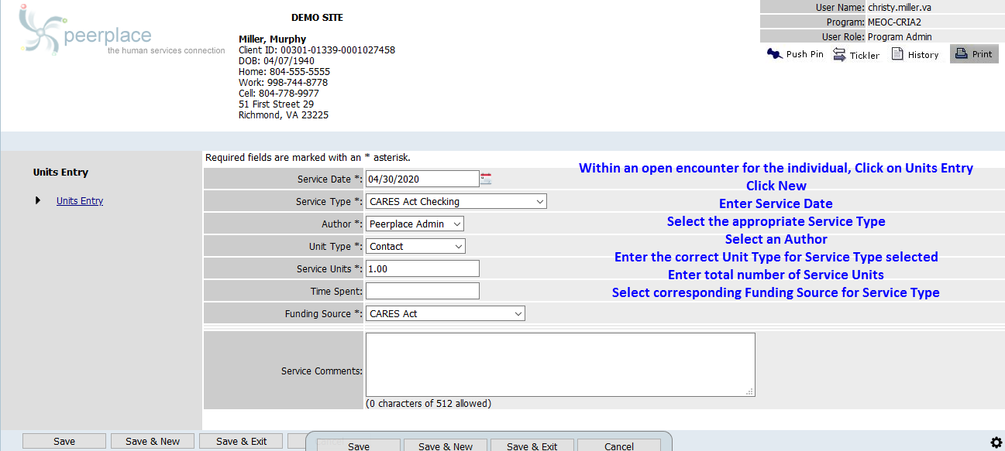
SAMPLE: Enter Units in CRIA2

Slide 13
Data Entry Disaster Declaration
Service units and individuals served under Disaster Declaration flexibility, are to be entered under pre-existing traditional Service Types already in use prior to COVID-19 and ‘flagged’ with the new ‘COVID-19’ value in the Funding Source field
‘COVID-19’ is not an actual funder, but merely a method on the system to flag which of the total units are Disaster Declaration
The funding source of ‘COVID-19’ is only to be used when flagging specific service units for Disaster Declaration and it is not to be used with Families First or CARES Act service types
Since not all agencies had Emergency and Checking in the original Area Plan, two new Service Types were added to each agency for Emergency and Checking

Slide 14
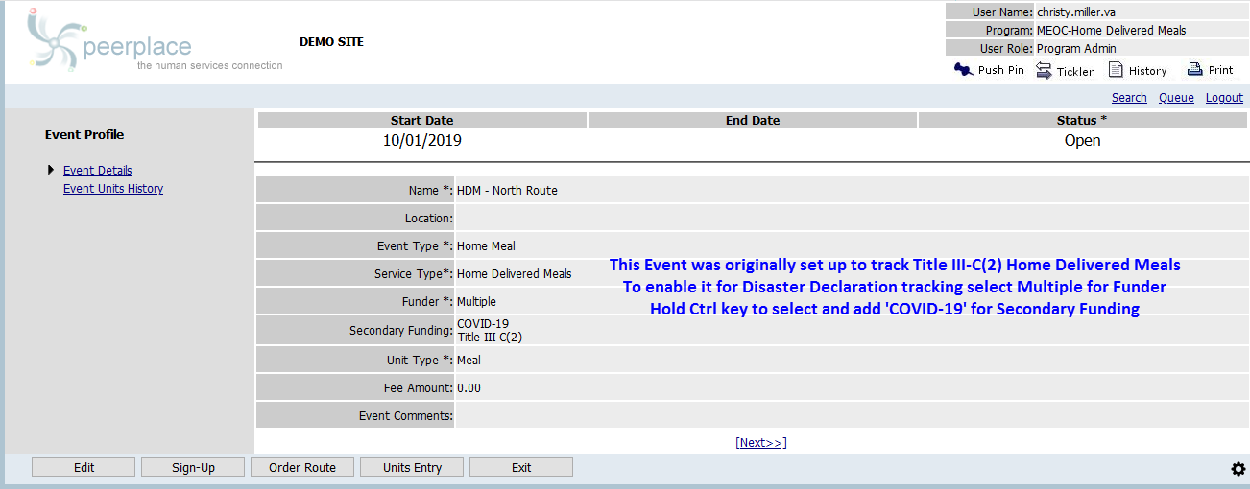
SAMPLE: Event Profile

Slide 15
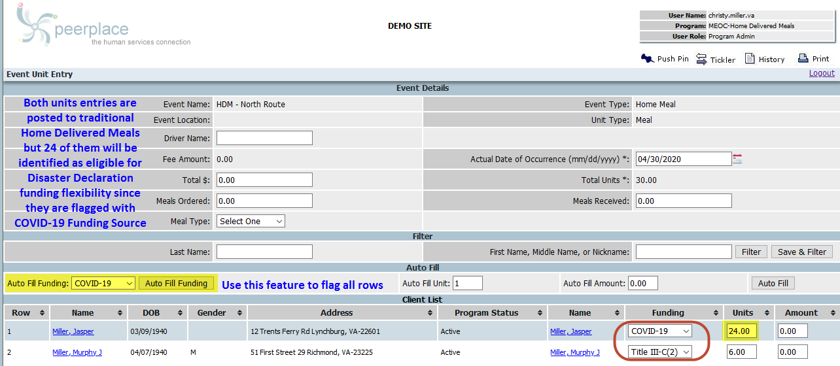
SAMPLE: Enter Units into Event

Slide 16
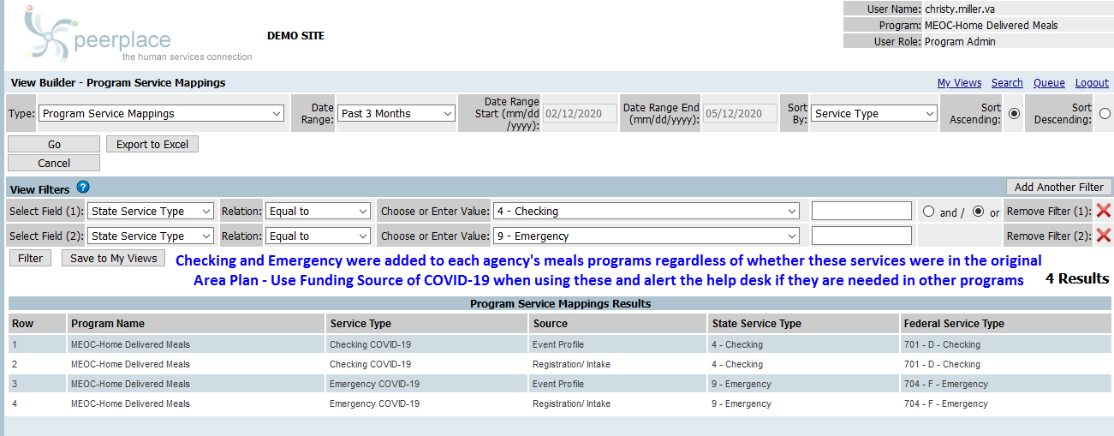
SAMPLE: Use Checking and Emergency COVID-19

Slide 17
Reports
Run ‘AAA Service Summary’ report to complete the AMR for your traditionally funded service units and individuals served as the totals on this report will include units flagged for Disaster Declaration and exclude those under CARES Act and Families First
Run the ‘Service and Units Summary’ report to complete the AMR OC for Families First and CARES Act and look at the State Service Type tab of the report to see the Families First and CARES Act Service units and individuals served
Run the ‘Service and Units Summary’ report to complete the AMR for Disaster Declaration and look at the State Service Type Funding Source tab of the report to see the Disaster Declaration units and individuals served

Slide 18
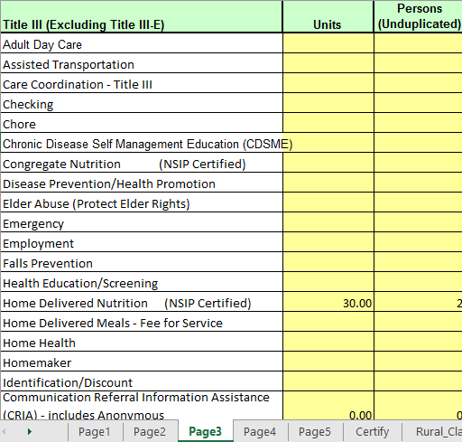
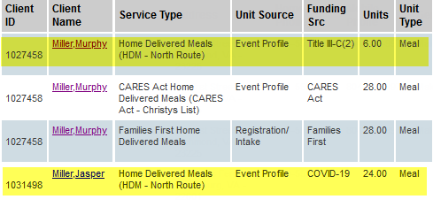
SAMPLE: AAA Service Summary
The AAA Service Summary correctly includes 2 individuals with a total of 30 units for Home Delivered Meals
24 of the total Home Delivered Meals units are included and also flagged for Disaster Declaration flexibility
The report correctly excludes the Home Delivered Meals entered as CARES Act and Families First

Slide 19
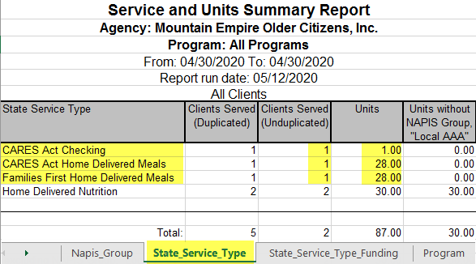
SAMPLE: Service and Units Summary
State Service Type Tab/CARES Act Families First
Use the PeerPlace Report named ‘Service and Units Summary’
Run that report for a date span of the start of the Federal Fiscal year (10/01/2019 as Start Date) through the end of the reporting month (example – reporting for April, use 04/30/2020 as End Date)
Select ‘All Programs’ for Program
Select ‘All’ for Clients
View the Excel spreadsheet tab named ‘State_Service_Type’ to see the State Service Types names including CARES Act and Families First

Slide 20
Families First – AMR OC
Use the PeerPlace Report named ‘Service and Units Summary’
Run that report for a date span of the start of the Federal Fiscal year (10/01/2019 as Start Date) through the end of the reporting month (example – reporting for April, use 04/30/2020 as End Date)
Select ‘All Programs’ for Program
Select ‘All’ for Clients
View the Excel spreadsheet tab named ‘State_Service_Type’ to see a the State Service Types names including Families First for units and individuals

Slide 21
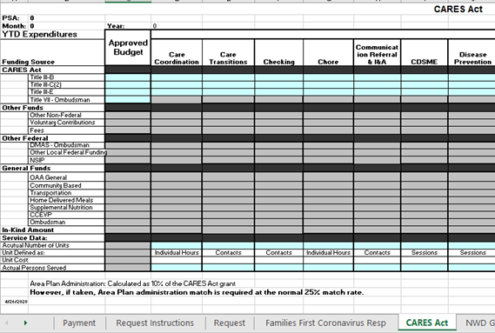
CARES Act – AMR OC
Use the PeerPlace Report named ‘Service and Units Summary’
Run that report for a date span of the start of the Federal Fiscal year (10/01/2019 as Start Date) through the end of the reporting month (example – reporting for April, use 04/30/2020 as End Date)
Select ‘All Programs’ for Program
Select ‘All’ for Clients
View the Excel spreadsheet tab named ‘State_Service_Type’ to see a the State Service Types names including CARES Act for units and individuals

Slide 22
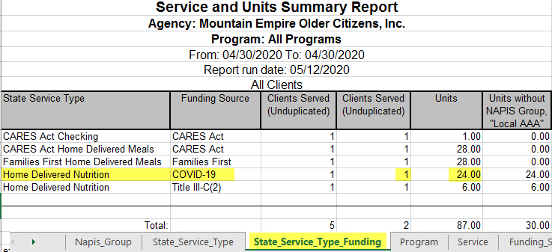
SAMPLE: Service and Units Summary
State Service Type Funding Tab/Disaster Declaration
Use the PeerPlace Report named ‘Service and Units Summary’
Run that report for a date span of the start of the Federal Fiscal year (10/01/2019 as Start Date) through the end of the reporting month (example – reporting for April, use 04/30/2020 as End Date)
Select ‘All Programs’ for Program
Select ‘All’ for Clients
View the Excel spreadsheet tab named ‘State_Service_Type_Funding’ to see the State Service Types names where Funding Source is COVID-19

Slide 23
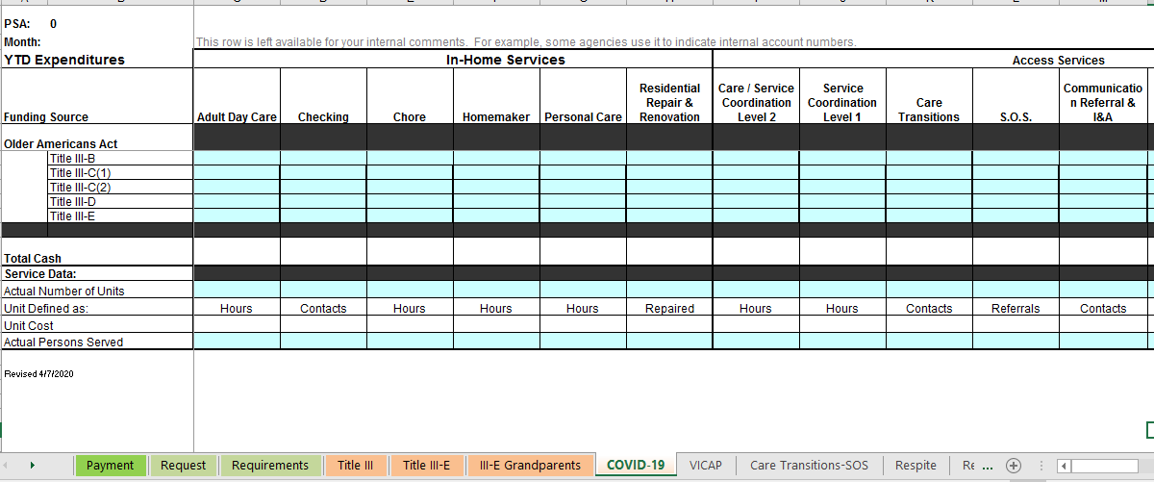
Disaster Declaration - AMR
Use the PeerPlace Report named ‘Service and Units Summary’
Run that report for a date span of the start of the Federal Fiscal year (10/01/2019 as Start Date) through the end of the reporting month (example – reporting for April, use 04/30/2020 as End Date)
Select ‘All Programs’ for Program
Select ‘All’ for Clients
View the Excel spreadsheet tab named ‘State_Service_Type_Funding’ to see a break down by State Service Type where Funding equal to COVID-19 (these are the Disaster Declaration units and individuals served)

Slide 24
Because Families First & CARES Act funding is specifically appropriated for COVID-19 response, we encourage the use of funding in the following order:
Families First
CARES Act
“Regular” Title III grant funds, starting with the oldest funds available first and utilize the flexibility of Disaster Declaration
10% Carryover Limit waived going into FY2021

Slide 25
Fiscal Guidelines & Reporting
Maurice Talley Tanya Brinkley Brenda Cooper

Slide 26
FFCRA
Funds must be accounted for separately from the regular issuance of Title III Older Americans Act funding.
Enter amounts on the AMR-OC exactly how they were allocated to you and then enter your expenditures under the services that were used.
States do not have to make transfers once the major disaster declaration has been declared. States have the ability to expend them in response to the identified needs.
Notes:
Speaker Notes:
The Families First Coronavirus Response Act funds have been issued under a separate grant award number; therefore, funds must be accounted for separately from the regular issuance of Title III Older Americans Act funding.
A Families First worksheet has been added to the AMR-OC form for you to request payment and track your expenditures, number of units and persons served. You will need to enter the amounts that your agency has been awarded exactly how they were allocated to you under the Approved Budget Columns and then update your YTD expenditures each month under the services that were used with the number of units and clients served. With the approval of the Major Disaster Declaration, we are able to open the funding sources to give you the flexibility to expend FFCRA C1 funds for Home Delivered Meals. This will prevent us from having to issue a Contract Modification to process a transfer from C1 to C2.

Slide 27
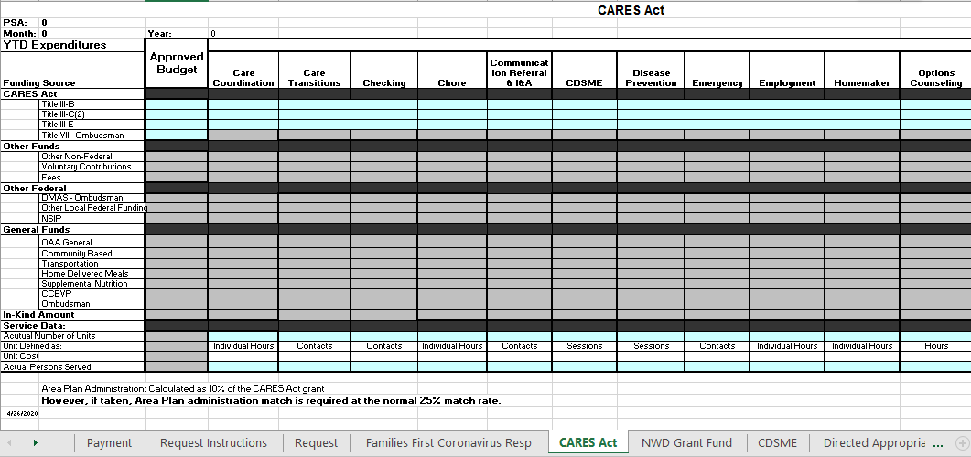
CARES Act
Funds must be accounted for separately from the regular issuance of Title III Older Americans Act funding.
Enter amounts on the AMR-OC exactly how they were allocated to you and then enter your expenditures under the services that were used.
States do not have to make transfers once the major disaster declaration has been declared. States have the ability to expend them in response to the identified needs.
Notes:
Speaker Notes:
The CARES Act funds are also being issued under a separate grant award number; therefore, funds must be accounted for separately from the regular issuance of Title III Older Americans Act funding. As with the Families First funds, a worksheet has been added to the AMR-OC form for you to request payment and track your expenditures, number of units and persons served. You will need to enter the amounts that your agency has been awarded exactly how they were allocated to you under the Approved Budget Columns and then update your YTD expenditures each month under the services that were used with the number of units and clients served. You will notice that Title VII –Ombudsman funds are the only funds that can not be expended under other services. Ombudsman funds can only be used for the Ombudsman program.

Slide 28
Major Disaster Declaration
No Additional Funding
Flexibility is provided for states – without the need for a separate application, transfer request, or request for a waiver -- to use existing allocations already made to them under Title III-B, C-1, C-2, D, and E for disaster relief.
States do not have to make transfers once the major disaster declaration has been declared. States have the ability to simply designate funds as “disaster relief” and expend them in response to the identified needs.
Reporting of funds reallocated for disaster relief should be identified and reported on the “COVID-19” worksheet, which has been added to the regular AMR.
Notes:
Speaker Notes:
The Major Disaster declaration that has been approved for The Commonwealth of Virginia, permits states to use any portion of the funds made available under any and all sections of the Act for disaster relief for older individuals. In this regard, flexibility is provided for states – without the need for a separate application, transfer request, or request for a waiver -- to use existing allocations already made to them under Title III-B, C-1, C-2, D, and E for disaster relief.
This means that a state may use Title III-B, C-1, C-2, D, and/or E funds for any disaster relief activities for older individuals or family caregivers served under the OAA, which may include, but are not limited to:
providing drive through, take out, or home-delivered meals,
providing well-being checks via phone, in-person, or virtual means, and
providing homemaker, chore, grocery/pharmacy/supply delivery, or other services.
To assist with the Major Disaster Declaration, we have added a worksheet to the regular AMR titled COVID-19. This is where you will report all of your COVID-19 expenditures after all of your new funding has been expended. This worksheet has the service columns listed with the funding sources that have been permitted to use open so that you can easily expend the funds as needed. This sheet is also where you will record the number of units and persons served for COVID-19 related expenses.

Slide 29
Because FFCRA & CARES Act funding is specifically appropriated for COVID-19 response, we encourage the use of funding in the following order:
State General Funds
Families First Coronavirus Response Act funding;
CARES Act funding;
“Regular” Title III grant funds, starting with the oldest funds available first.
10% Federal Carryover Limit waived going into FY2021
Please note that carryover is not allowed for state general funds. The Area Agency shall submit its final request for state general funds by June 12th and shall obligate all such funds by June 30th of the Contract year and liquidate by September 30th of the reporting year or the Area Agency shall return the unspent state general funds to the State Agency.
Notes:
Speaker Notes:
Because FFCRA & CARES Act funding is specifically appropriated for COVID-19 response, we encourage the use of funding in the following order: State General Funds; Families First Coronavirus Response Act funding; CARES Act funding; then “Regular” Title III grant funds, starting with the oldest funds available first. With the additional supplemental funding, we realize that it may be hard to expend all of your regular OAA funding in a timely manner. Because of this, the carryover limit will be waived for any existing 2020 OAA federal funds going into Area Plan FY2021.
Please note that Carryover is not allowed for state general funds. The Area Agency shall submit its final request for state general funds by June 12th and shall obligate all such funds by June 30th of the Contract year and liquidate by September 30th of the reporting year or the Area Agency shall return the unspent state general funds to the State Agency.

Slide 30
Question and Answer
Facilitated Group Discussion

