Slide 1
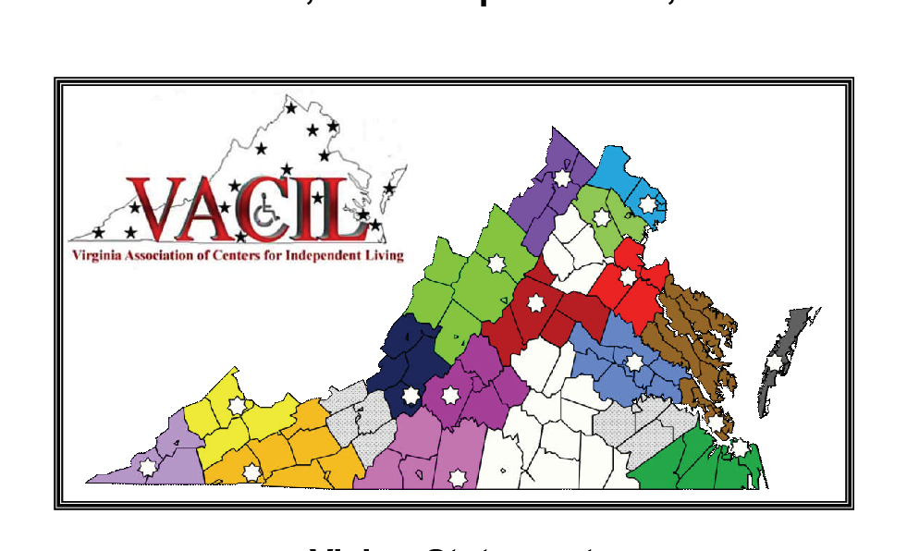
Mission Statement:
People with disabilities will have
a community based, consumer-directed
service delivery system

Slide 2
PURPOSE
VACIL is a statewide association of CILs that advocates for the integration and inclusion of people with disabilities into all aspects of society. The association also promotes the professional development, improvement, and expansion of community-based, consumer-controlled CILs, and promotes community education throughout the Commonwealth of Virginia.

Slide 3
Goals
VACIL’s goals are for individuals with disabilities to:
improve the quality of their lives;
determine their own lifestyles;
participate in all aspects of society;
secure their human and civil rights and to
protect a mechanism for consumer control and policy direction of the service delivery systems that impact their lives.

Slide 4
Today, there are 17 CILs in Virginia and 4 satellites in the Commonwealth of Virginia
Access Independence, Inc
Appalachian Independence Center, Inc
Blue Ridge Independent Living Center
Clinch Independent Living Services
disAbility Resource Center
Disability Rights and Resource Center
Eastern Shore Center for Independent Living
Endependence Center, Inc
ENDependence Center of Northern VA

Slide 5
Independence Empowerment Center
Independence Resource Center
Junction Center for Independent Living
Lynchburg Area Center for Independent Living
New River Valley Disability Resource Center
Penninsula Center for Independent Living / Insight Enterprises
Resources for Independent Living
Valley Associates for Independent Living, Inc

Slide 6
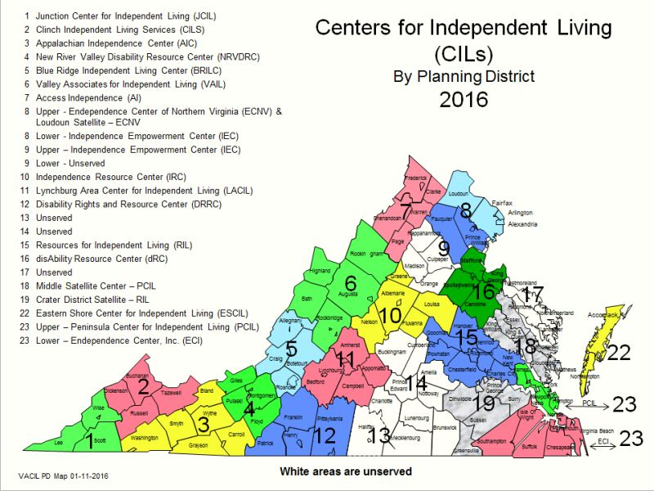
Areas in white are unserved.
Areas that are light grey with dots are served by satellite offices.

Slide 7
Centers for Independent Living (CIL)
"A CIL is a consumer-controlled, community-based, cross-disability, non-residential, private, non-profit agency that is designed and operated within a local community by individuals with disabilities and provides an array of independent living services which are described in the Rehabilitation Act of 1973, as amended."
CILs' Core Services
Advocacy
Peer Counseling
Skills Training
Information and Referral
Transition Services for Youth and from Nursing Home
http://www.vacil.org/

Slide 8
All Centers for Independent Living are private 501c3 organizations that are governed by an independent Board of Directors. Each provides the 5 core services but they do not all provide them in identical manner.

