Slide 1
Person-Centered Trauma Informed Care, Part II
Secondary Trauma
and Self-Care
Amy Markman Goldberg &
Marilyn Simon Weinberg
Trauma Informed Initiative

Slide 2
Objectives of Today’s Training
Everyone will have an increased understanding of what it means to be “Person Centered”
Everyone will have an increased awareness of the impact and symptoms of Secondary or “Vicarious” Trauma
Everyone will leave with an increased awareness of strategies to become more “Stress-Resistant”

Slide 3
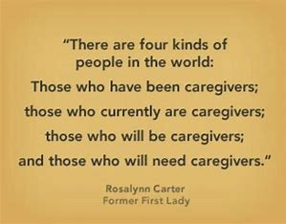

Slide 4
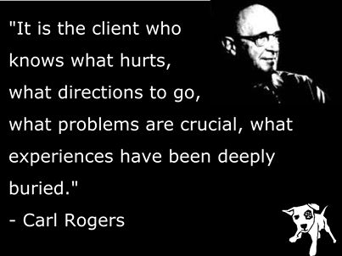
Notes:
What does it mean to be Person-Centered?
Big behaviors tells us a lot about a person’s life and their needs.
This allow us to have empathy when we normally wouldn’t
Person-centered therapy, also known as Rogerian therapy, originated in the work of the American psychologist, Carol Rogers, who believed that everyone is different and, therefore, everyone’s view of his or her own world, and ability to manage it, should be trusted. Rogers believed that all of us have the power to find the best solutions for ourselves and make appropriate changes in our lives.
Person-centered therapy was a movement away from the therapist’s traditional role—as an expert and leader—toward a process that allows clients to use their own understanding of their experiences as a platform for healing. The success of person-centered therapy relies on three conditions:
1) Unconditional positive regard, which means therapists must be empathetic and non-judgmental to convey their feelings of understanding, trust, and confidence that encourage their clients to make their own decisions and choices
2) Empathetic understanding, which means therapists completely understand and accept their clients’ thoughts and feelings
3) Congruence, which means therapists carry no air of authority or professional superiority but, instead, present a true and accessible self that clients can see is honest and transparent.
Professor example: Jumping on the train with the client

Slide 5
Defining what it means to be “Person-Centered”
Person-centered care is a way of providing care to people in which the unique person and their preferences are emphasized.
Instead of the problem or disease, the expected symptoms and challenges, and the lost abilities of the person, person-centered care focus on just that, the person, their individual strengths, preferences, needs and desires.
Notes:
The role of staff, family, and other team members is to enable and assist the person to identify and access a unique mix of paid and unpaid services to meet their needs, and to provide support during planning and implementation.

Slide 6
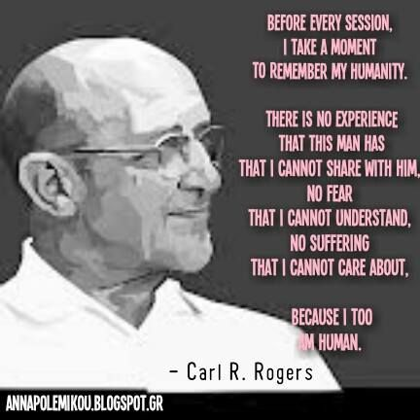
Notes:
Put Simply: “Person-Centered” means being able to see the people that we support with increased empathy, and to act accordingly
CREATE BACKSTORY

Slide 7
Person Centered Trauma Informed means:
Understanding that the person in front of us has experiences and needs that we may never fully understand
Notes:
Use vocal empathy:
Avoid phrases such as “I know how you feel”. Although often well-intentioned, such statements are often perceived as patronizing, and aren’t true. Most of us cannot imagine how survivors of trauma feel but always come from a place of understanding and if you don’t understand, be honest and acknowledge when you need the person you are working with to clarify or explain things that you don’t understand.

Slide 8
Person Centered Trauma Informed means:
Honoring these experiences, and providing dignity in their ability to express their preferences
Notes:
Acknowledge:
Assure clients that they are being heard and confirm that their message is of value and being taken seriously. In the case of Sarah from our last workshop, statements like, “You hate throwing out food, it seems like a waste to you”, demonstrates their experiences are being understood, their dignity is being not only recognized but honored.

Slide 9
Listening to Understand Goes Beyond Just Hearing
Listening is paying attention with the intention of understanding
Notes:
Listening is paying attention with the intention of understanding

Slide 10
Listen
When I ask you to listen to me and you start giving me advice,
You have not done what I have asked.
When I ask you to listen to me and you begin to tell me
why I shouldn’t feel that way
You are trampling on my feelings.
When I ask you to listen to me and you feel like you have to do something
To solve my problem you have failed me.
Strange as that may sound.
Listen: All that I ask is that you listen to me
Not talk or do- just hear me.
When you do something for me that I can do for myself
You contribute to my fear and inadequacy.
But when you accept as a simple fact
That I feel what I feel, no matter how irrational
then I can quit trying to convince you
And get about the business of understanding what’s behind them.
So please hear me, and if you want to talk, wait a minute for your turn
And I will listen to you.

Slide 11
Person Centered Trauma Informed means:
Truly Accepting that each of us “is perfectly developed given the experiences that we have endured”

Slide 12
“Your interpretation guides your intervention”
Notes:
Be willing to accept invitations to enter into another person’s world without trying to fix it
Change your mindset from working to appreciating
Acknowledge and utilize their expertize
Respect their journey, but avoid over analyzing it.
Get comfortable being with

Slide 13
“Trauma-Informed” review

Slide 14
What is Trauma?
Exposure to an incident, or series of incidents, that is emotionally disturbing or life threatening
Defined as an any experience that creates an undue, prolonged amount of stress on the brain

Slide 15
Recognition that these patterns of stress create real changes in the physiology of traumatized or overly stressed people…..
Including those of us in
helping roles!!
Notes:
“Inevitable occupational challenge”; however the consequences of this exposure are not inevitable.
Vicarious trauma can be prevented or managed, but it takes effort and dedication by the individual and the agency
Reference back to Carl Rogers– humanity– we are humans too!
Acknowledge that this might be triggering for some people---

Slide 16
Notes:
A single trauma can permanently alter our defense circuitry. So imagine if that trauma is repeated, over and over again, for years at a time.
These physical, emotional, psychological and intellectual effects may persist across the lifespan (Anda, et al., 2006; Spinazzola, Blaustein, & van der Kolk, 2005).
“This creates a confusing clinical picture that does not fit neatly into our current inadequate models of categorization”.

Slide 17
Results of Secondary Exposure:
PTSD
Secondary Traumatic Stress
Compassion Fatigue
Burn out
Notes:
One study indicated that 34% of victims services workers met criteria for a PTSD diagnosis (not just compassion fatigue or burn-out).
Only 10% of the general population meet this criteria!
The DSM changed the diagnosis of PTSD: no longer direct/actual or threatened trauma. Added indirect trauma: chronic exposure or accumulated stress.
This affects performance, moral, behaviors, task avoidance or obsession, lower quality care, low motivation, working too hard
Organizational impact: loss of productivity, low organizational health, staff turnover

Slide 18
“losing themselves in the profession they love”
Notes:
The expectation that we can be immersed in suffering and loss on a daily basis and not be touched by it is unrealistic.
Just like we cannot expect to stand in a rain puddle in a rain storm and not get wet

Slide 19
Is everyone impacted the same way?
How we interact with our exposure to trauma and stress is key to self-care
Notes:
None of us are immune to the effects of trauma
None of us lead adversity free lives

Slide 20
“you can’t stop the waves, but you can learn to surf”

Slide 21
Neuroplasticity
We can change the way we think through intentional practice and self talk
“change the narrative, change the neuropathway”
Notes:
The brain, as we reviewed in the previous session, is protective, reactive and self-centered.
It is wired this way to help us survive→ but we need to also remember that we are able to shape and train our brains in new ways.
We need to “lift heavier weights” in being intentional– build new neural pathways (aka brain maps) on how to manage the stress in our lives.
This is a skill that take PRACTICE, just like learning to tie our shoelaces.

Slide 22
Suggested Reading by: Laura van Dernoot Lipsky with Connie Burk

Slide 23
Trauma Exposure Response
Feeling helpless
and hopeless
Grandiosity
A sense that one can never do enough
Addictions
Inability to Empathize/
Numbing
A Trauma Exposure Response
Hypervigilance
Anger and Cynicism
Diminished Creativity
Fear
Inability to Embrace Complexity
Guilt
Sense of Persecution
Minimizing
Chronic Exhaustion
Physical Ailments
Dissociative Moments
Inability to Listen/
Deliberate avoidance

Slide 24
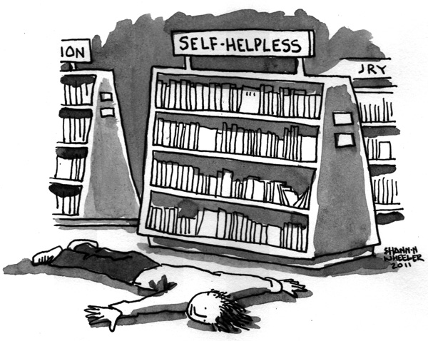
Feeling Helpless and Hopeless
Feeling personally responsible for the situation and its resolution
Feeling that the situation has no end in sight

Slide 25
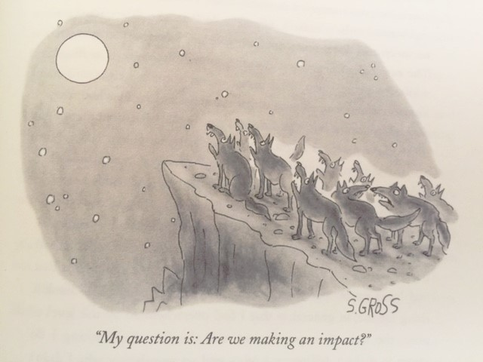
Despite your best efforts…
Feeling that the experiences will keep on happening over again

Slide 26
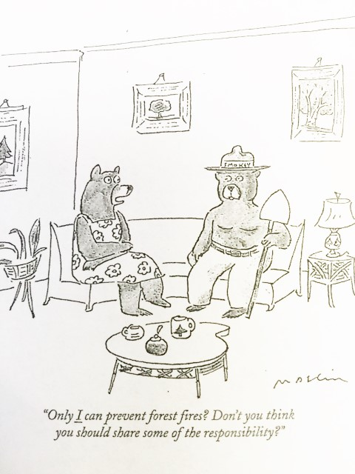
A sense that one can never do enough

Slide 27
Hypervigilance
An attempt to restore sense of safety by anticipating or seeing everything as a potential threat, and then acting accordingly

Slide 28
Hypervigilance, continued
Become wholly focused on our jobs to the extent that being present for anything or anyone else seems impossible

Slide 29
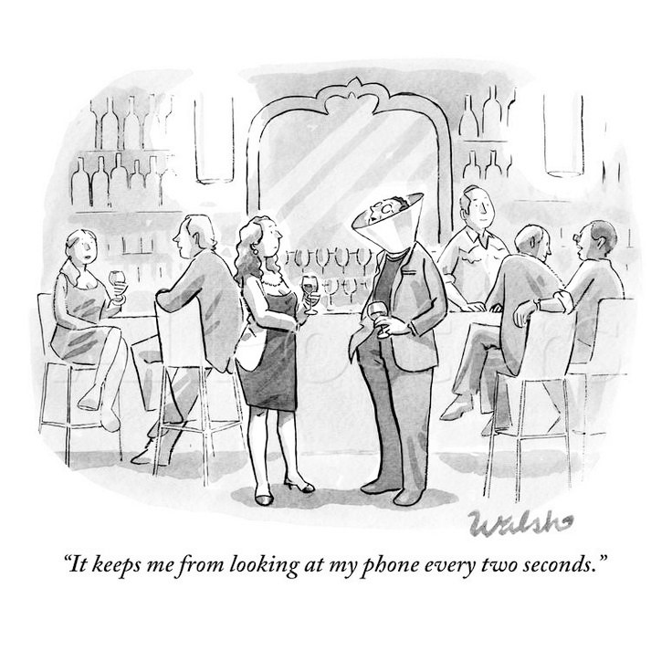
Hypervigilance, continued
This is often reinforced by technology that allows us to be connected anytime, anywhere

Slide 30
Feeling of Oppression
Leads to scapegoating others
Conformation due to fear
Leads to rigid thinking
Overgeneralizations
Denigration and dehumanization of others

Slide 31
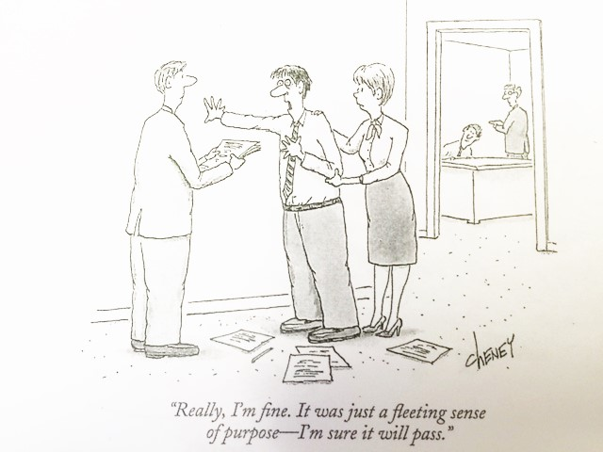
Diminished creativity
We lose our sense of purpose in the work
We find ourselves craving more structure
“Just tell me what to do” phenomenon

Slide 32
Inability to Embrace Complexity
Crave clear sign of good/bad, right/wrong
Passing judgement on others
Making assumptions
Being very shortsighted
Feel a need to “take sides”, making someone the “bad guy”
Leads to gossip, cliques, rigidity, negativity

Slide 33
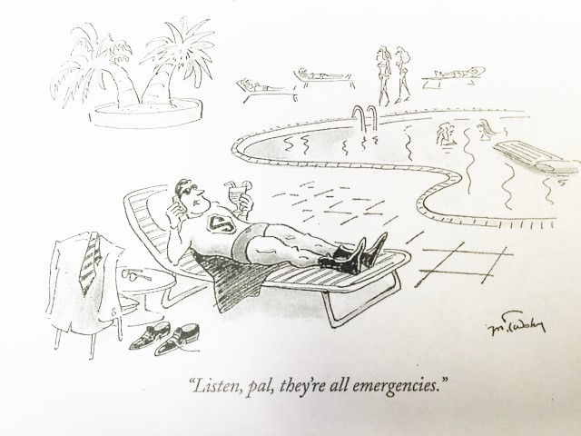
Minimizing
Occurs when we trivialize a situation by comparing it with another situation that we regard as more intense
“It’s not that bad”
Downplaying other’s stories
Trivialize situations

Slide 34
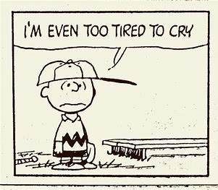
Chronic Exhaustion and Physical Ailments

Slide 35
Chronic Exhaustion/Physical Ailments, continued
Feeling overwhelmed by urgency, but exhausted from the effort
We push ourselves harder to show that we aren’t affected, and ignore health related complaints
Notes:
Relates back to the hyperarousal that we reviewed earlier

Slide 36
This sense of fatigue becomes the norm
Notes:
Our amygdala is constantly firing due to the stress--- cortisol and adrenaline rushes through our bodies, just trying to get through the day.
It is not a badge of honor to be tired all the time.

Slide 37
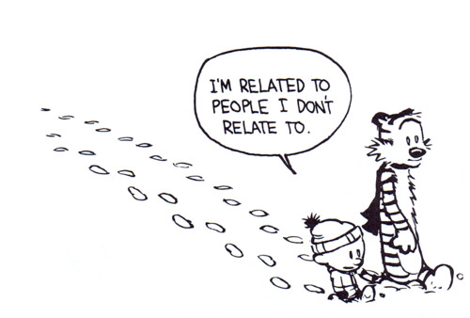
Inability to Listen and Deliberate Avoidance
We begin to feel justified by the avoidance because we feel that is what we receive
Increased isolation
Begins to affect personal life
Notes:
Research shows that:
40% of people in the United States feel lonely
70% of people at work feel lonely—
Loneliness hinders creativity and weakens executive function (pre frontal cortex)

Slide 38
Dissociative Moments
Occur at times when you mentally just “check out”
Protective reaction, defense mechanism
These are normal reactions and should be recognized
Become problematic when they become intrusive and overwhelming

Slide 39
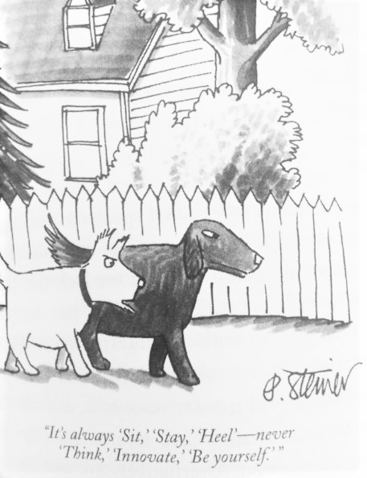
Sense of Persecution
Feeling of a lack of efficacy in one’s life
We become convinced that others are responsible for our well-being
Can become a “self-fulfilling prophecy”
We begin to see everything through a lens that supports this idea of persecution

Slide 40
Guilt
This is one of the strongest signs of trauma exposure
Can undermine authenticity
It blocks our other feelings as well
You cannot turn off one emotion and expect all the others to remain on
We tend to minimize our own joy and wellness
E.g. we feel guilty when things go well for us, and therefore minimize them– taking away our own happiness
Notes:
Remind folks that the easiest thing they can do for others (and for themselves) is to smile.
Authentically wanting to help others, but our own stress responses undermine the truth that you want to help.

Slide 41
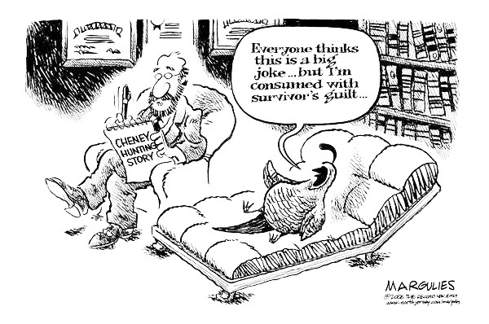
Guilt, continued
We can get caught up in our own discomfort about the disparity between our lives and the lives of those we serve

Slide 42
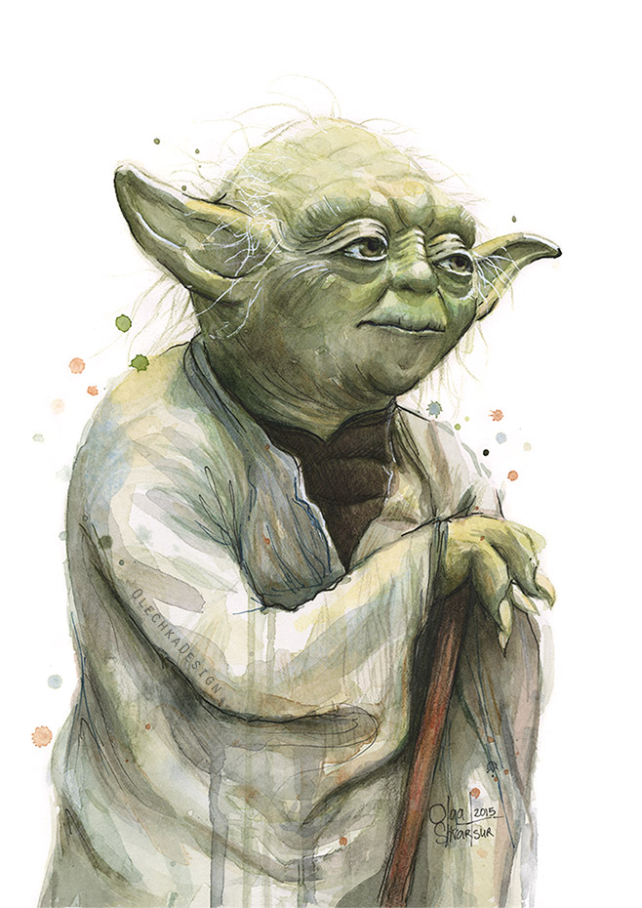
Fear
When we acknowledge our own fear, we have the opportunity to learn new ways to handle it
“Fear is the path to the Dark Side.
Fear leads to Anger.
Anger leads to Hate.
Hate leads to Suffering.”
---Yoda

Slide 43
Anger and Cynicism
Anger is a natural feeling
In and of itself it does no harm
If we are not comfortable and connected to the reasons for our own anger, we will struggle to get past it
We end up taking it out on others
Feel irrational resentment to others

Slide 44
Anger and Cynicism, continued
Anger can easily turn to cynicism
Portrayed often as humor
Makes us unable to deal with the feelings
Warps our attitude of the world around us

Slide 45
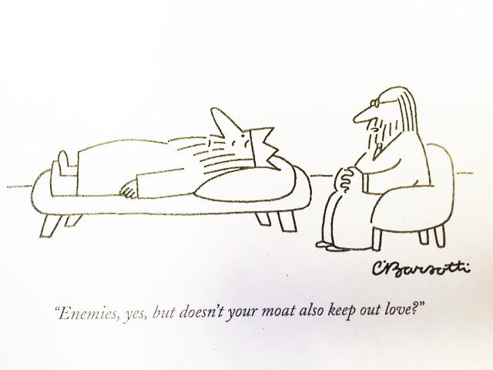
Inability to Empathize/Numbing
Feelings become indistinguishable from one another
You cannot turn off just one emotion; you end up turning off all of them

Slide 46
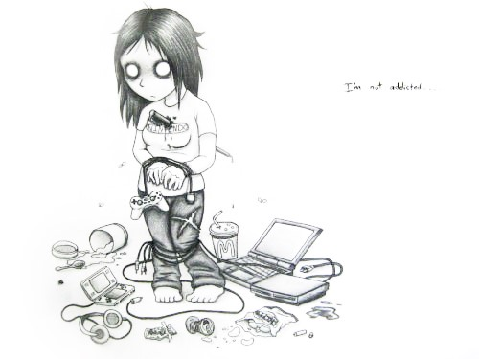
Addictions
“An attachment so strong that is persists despite our understanding of its potentially destructive nature”
Drugs
Alcohol
Food
Sex
Adrenaline
Overwork
Technology
Checking out
Trying to numb

Slide 47
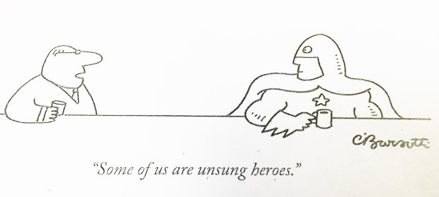
Grandiosity
An Inflated Sense of Importance Related to One’s Work
When work becomes the center of our lives, or we become fixated by the need to be the one to “do it all”
Distorted belief that because our work is important, then so are we

Slide 48
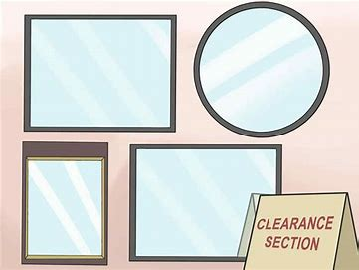
Do any of these responses sound familiar?
Notes:
At your table, share with one another the descriptions that struck a cord --- which ones you most strongly identify with.
There is no shame in recognizing these within yourselves. It is a healthy to recognize that you might be impacted– and to seek out support.
Sometimes it’s hard to hold a mirror up and really look at ourselves, how stress of caring for others might be impacting our lives.
If you find it hard to see this for yourself, find a trusted person and ask them for honest feedback on how they think you’re doing.
You might be surprised by their responses.

Slide 49
Stress---
None of us are immune to the effects of Stress
But there are ways that we can become “Stress Resistant”
Notes:
The reactions above are normal. Remember from the PCTI part I that the brain is hard wired to perceive threat.
We tend to dismiss positive or neutral things
Our brains are hard wired to be protective, self-centered and reactive.

Slide 50
Notes:
Stress is good in small amounts; imprints memories better and you learn more. It is when stress is dosed out in large amounts that we begin to see ill effects of stress.
“Caustic Discourse”—stress in the world; they are not distractions; they have neuroplasticity effects; affects your brain in REAL ways.

Slide 51
Rethinking Self-Care: Everyday Micro Practices, 2015 Ashley Davis Bush, LICSW
“Advances in neuroplasticity underscore… [that] small repetitive practices matter, both in creating new neural networks in our brains and in creating sustainable self care”.

Slide 52
Becoming “Stress Resistant”
Learning ways to recognize your emotions
Learning ways to manage yourself
Creating an Internal Locus of Control over your own life
Notes:
Remember– recognizing emotions is important. The amygdala get all fired up and activate the stress response system– we then act in ways sometimes that we don’t like or understand.
We have to be able to understand our own emotions before we can start to change how we perceive them (and other).

Slide 53
Stress Resistant People A sense of personal control
Perceive a connection between actions and how they feel
They believe in their own capacity to influence the course of their lives
Notes:
In the moments of stress, we are only able to identify our emotions/name our feeling in the moment about 36% of the time (Dr. Laura Gronewold)
Surface emotion vs underlying emotion– tends to be identified as anger or frustration (which is the most commonly named, when in fact it might be disappointment, confusions, hurt, etc.).
Need to create the ability to recognize our own emotions– intentional process requiring us to slow down and create non-judgmental awareness and “gentle matter of fact-ness”.

Slide 54
Stress Resistant People Pursuit of Personally Meaningful tasks
Being present and engaged in their own lives, not just the lives of others or of events
Being active, not passive, during challenging times
Notes:
Express it (in a positive way!): journal, talking it through, etc.
Name it: internal, understanding core feeling
Own it: It becomes yours rather than blaming someone else.

Slide 55
Stress Resistant People Healthy Lifestyle Choices
Take time to explore what this means for you
Look at making small changes initially that can help support a healthy lifestyle
Notes:
Mindfulness
Grounding
Rhythmic Activity
Incorporate a grounding technique here

Slide 56
Stress Resistant People Social Support
Develop and nourish relationships with others
Make conscious efforts to reduce your isolation
Notes:
Remember– especially in moments of high stress– we are often unable to recognize our own emotions– only 37% of the time do we do this accurately!

Slide 57
PRACTICE SELF REFLECTION
Where are you putting your focus?
This can take different forms
Sometimes it means concentrating on what’s in front of you
Sometimes it means stepping back
Notes:
We need to have increased empathy for ourselves– and our co-workers– just as we would for the people that we support. Talk about how others are feeling, without it becoming a ritualistic complaining.
We all need to vent at times– it is when the venting becomes cynical and the norm that we need to slow down and look at what else might be happening

Slide 58
Reaching Out to Others
Isolation is one of the biggest indicators of burn out and experiencing secondary trauma
Reducing our own isolation has to be an intentional process
Notes:
Research has found that loneliness and weak social connections shorten our life spans, similar to smoking a pack a day!
Make it intentional– create new patterns and new ways of training our brain to seek out others rather than isolating ourselves from them.
Our brains are hard wired for connections– but also for suspicion.
That is where mindfulness comes in--- like any skill, this takes practice!
Build stronger connections muscles by “lifting heavier weights”

Slide 59
“Micro-moments of Connection”
Smile!!
Laugh
Make eye contact
Be silly!
Put your phone away!!
The people with whom we feel the most love are those with whom we have the most micro-moments
Notes:
Even in this room– we are connecting. Welcome to stay for lunch to have opportunity to connect to others.
Connect your pipe cleaner creations to one another within your table – it makes your creations stronger and creates a micro-moment of connection

Slide 60
All humans, somewhere within, have the urge to be heroic, to transcend circumstances, to develop one’s powers, to overcome adversity, to stand up and be counted.
– Dennis Saleeby

