Slide 1
Reviewing Leases in Medicaid DD Waiver Residential Settings
DBHDS Office of Community Housing
Jeannie Cummins, Senior Regional Housing Coordinator
j.cummins@dbhds.virginia.gov

Slide 2
Agenda
Why are leases required in residential settings?
Covered settings
Key terms and provisions a lease should contain
Terms and provisions a lease should NOT contain
Problematic lease provisions
Other key VRLTA protections for tenants and landlords
What to do if a lease has problematic terms & provisions
Questions and Answers

Slide 3
Why Are Leases Required in Residential Settings?
Centers for Medicare & Medicaid Services (CMS)
Home and Community Based Services (HCBS) Settings Rule
(CMS 2249-F/2296-F)
Applies to Medicaid programs that fund HCBS, including Virginia’s Medicaid Waiver program for people with developmental disabilities
Establishes requirements for the quality of settings eligible for Medicaid HCBS reimbursement
Notes:
CMS established the Home and Community Based Services (HCBS) Settings Final Rule in January 2014 (CMS 2249-F/2296-F)
The rule applies to several Medicaid programs that offer HCBS, including the Medicaid 1915(c) Waiver program
The intent is to:
enhance the quality of HCBS
provide additional protections to HCBS program participants
ensure individuals receiving services through Medicaid’s HCBS programs have full access to the benefits of community living
The rule establishes requirements for the qualities of settings eligible for reimbursement for Medicaid HCBS. Settings must:
be integrated in and support full access to the greater community;
be selected by the individual from among setting options;
ensure individual rights of privacy, dignity and respect, and freedom from coercion and restraint;
optimize autonomy and independence in making life choices; and
facilitate choice regarding services and who provides them.

Slide 4
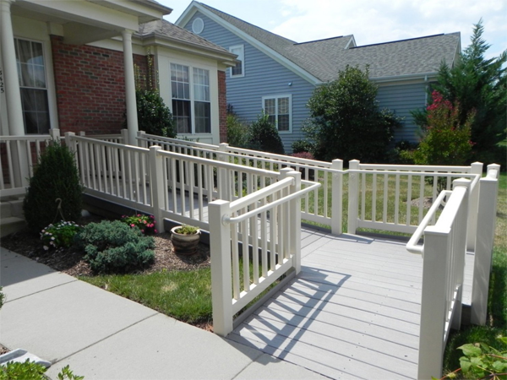
Why Are Leases Required in Residential Settings?
HCBS Settings Rule
Provider-owned or controlled HCBS residential settings have additional requirements
Setting must be physically accessible
Individuals must:
have privacy in their unit
control their own schedule
be able to have visitors at any time
have a lease or other legally enforceable agreement with similar protections
Notes:
The rule creates additional requirements for provider-owned or controlled HCBS residential settings:
the setting must be physically accessible
individuals must have privacy in their unit including lockable doors, choice of roommates and freedom to furnish or decorate the unit;
individuals must control their own schedule including access to food at any time;
individuals can have visitors at any time; and
individuals must have a lease or other legally enforceable agreement providing similar protections

Slide 5
Why Are Leases Required in Residential Settings?
HCBS Settings Rule
In provider-owned or controlled residential settings:
the unit or dwelling is a specific physical place that can be owned, rented, or occupied under a legally enforceable agreement
the individual has the same responsibilities and protections from eviction that tenants have under landlord/tenant law
Notes:
In provider-owned or controlled residential settings:
the unit or dwelling is a specific physical place that can be owned, rented, or occupied under a legally enforceable agreement by the individual receiving services
the individual has, at minimum, the same responsibilities and protections from eviction that tenants have under the landlord/tenant law of the State, county, city, or other designated entity (e.g., the Virginia Residential Landlord Tenant Act)

Slide 6
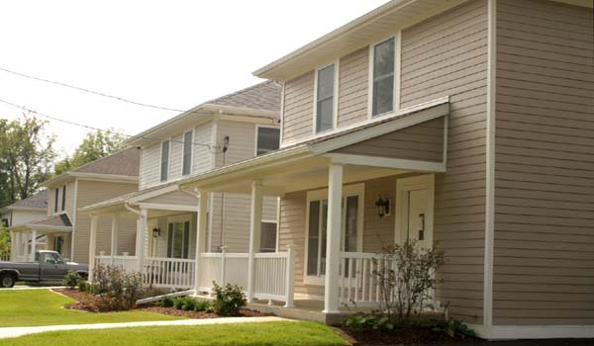
Covered Residential Settings
Medicaid DD Waiver-funded residential settings covered by the HCBS Settings Rule in Virginia:
Group home Residential
Sponsored Residential
Supported Living

Slide 7
Lease Terms & Provisions
The following slides about what leases should and should not contain are for informational purposes only.
All parties should consult legal counsel prior to executing any legally binding agreement.

Slide 8
Terms & Provisions Leases SHOULD Contain
A statement that the lease is enforceable under the Virginia Residential Landlord Tenant Act (VRLTA)
A description of the property address, setting type and characteristics
Areas of the property to which the tenant has
sole access
communal access
restricted or prohibited access
Notes:
Leases with providers who operate provider-owned or provider-controlled Medicaid Waiver funded residential settings should contain the following terms and provisions:
A statement that the lease is enforceable under the Virginia Residential Landlord Tenant Act (VRLTA)
A description of the property address, setting type and characteristics, e.g.:
a group home consisting of a 4 bedroom detached single family home located at 123 Easy Street, Anywhere VA 12345
a sponsored residential program consisting of a 3 bedroom townhouse located at 111 Doe St, Hometown, VA 23456
Areas of the property which the tenant
has sole access
has communal access
has restricted or prohibited access

Slide 9
Terms & Provisions Leases SHOULD Contain
Length of lease agreement (e.g., month to month, 1 year)
Terms for renewing or terminating the lease (e.g., X days prior written notice)
Rent terms:
date rent is due each month and the date by which it is considered late
monthly rent amount
any pro-ration for a partial month
fees for late rent, bounced checks
Any required fees in addition to the rent amount
Notes:
Leases with providers who operate provider-owned or provider-controlled Medicaid Waiver funded residential settings should also contain:
The length of lease agreement (e.g., month to month, 1 year)
Terms for renewing or terminating the lease (e.g., X days prior written notice)
The rent terms:
date rent is due each month and the date by which it is considered late
monthly rent amount
any pro-ration for a partial month
fees for late rent, bounced checks
An explanation of any required fees in addition to the rent amount (e.g., deposits, food, household supplies)
Late rent fee cannot exceed the lesser of 10% of the monthly rent amount or the balance of rent owed
The processing fee for payment of rent with a back check cannot exceed $50

Slide 10
Terms & Provisions Leases SHOULD Contain
Description of who provides and pays for each utility (landlord or tenant)
House rules and tenant responsibilities regarding:
Pets
Visitors
Noise
Decorating
Housekeeping
Smoking
How tenant/landlord damages will be handled
Conditions under which the landlord can access the tenant’s space, e.g.:
24 or 48 hour written notice for non-emergencies
no notice for emergencies

Slide 11
Terms & Provisions Leases SHOULD Contain
Explanation of:
what constitutes remediable and non-remediable breaches of the agreement by the landlord/tenant
remedies available to the landlord or the tenant if either breaches the agreement
the process for resolving disputes related to the agreement
Notes:
Finally, leases with providers who operate provider-owned or provider-controlled Medicaid Waiver funded residential settings should also contain an explanation of:
What constitutes remediable and non-remediable breaches of the agreement by the landlord/tenant
Remedies available to the landlord and tenant if either breaches the agreement
The process for resolving disputes related to the agreement

Slide 12
Terms & Provisions Leases SHOULD NOT Contain
Provisions that require the tenant to:
agree to waive or forgo rights or remedies under the Virginia Residential Landlord Tenant Act (VRLTA)
authorize any person to confess judgement on a claim arising out of the rental agreement
agree to pay the landlord’s attorney fees (except as permitted by VRLTA)
Notes:
Now let’s examine terms and provisions that a lease or rental agreement SHOULD NOT contain. The VRLTA calls out certain provisions that are prohibited in rental agreements. Prohibitions that apply to provider-owned and controlled residential settings include provisions that require the tenant to:
agree to waive or forgo rights or remedies under VRLTA
authorize any person to confess judgement on a claim arising out of the rental agreement
agree to pay the landlord’s attorney fees (except as permitted by VRLTA)

Slide 13
Terms & Provisions Leases SHOULD NOT Contain
Provisions that require the tenant to:
agree to
exculpate or limit landlord liability to the tenant arising under law or
indemnify the landlord for that liability or any associated costs
pay for a security deposit AND purchase a bond or commercial insurance policy to secure the performance of the terms and conditions of a rental agreement, if the total of the security deposit and bond or insurance coverage exceeds two months’ rent
Notes:
Under VRLTA, rental agreements also cannot contain provisions that require the tenant to:
agree to the exculpation or limitation of any landlord liability to the tenant arising under law or to indemnify the landlord for that liability or any associated costs
pay for a security deposit AND purchase a bond or commercial insurance policy to secure the performance of the terms and conditions of a rental agreement, if the total of the security deposit and bond or insurance coverage exceeds two months’ rent

Slide 14
Terms & Provisions Leases SHOULD NOT Contain
Provisions that:
allow the landlord to charge excessive fees for late rent
require the tenant to pay more than 2 month’s rent in a security deposit and/or damage insurance
2.1: If rent is not paid by the fifth of the month, it is considered overdue. The penalty for overdue rent is $500 per month.
Notes:
Finally, rental agreements cannot contain provisions that
allow the landlord to charge excessive fees for late rent (more than 10% of the monthly rent or 10% of the unpaid balance owed)
require the tenant to pay more than 2 month’s rent in a security deposit and/or damage insurance

Slide 15
Problematic Lease Terms & Provisions
Problematic provisions are not illegal, but may cause the tenant substantial hardship
Examples:
requiring the tenant to pay a security deposit AND first and last month’s rent
prohibiting multiple sources of rent payment
creating onerous notice requirements for the tenant (e.g., more than 60 day written notice to non-renew the lease)
charging the tenant the remaining value of the lease contract if the tenant fails to provide proper notice to vacate or to non-renew the lease
requiring tenants pay for the landlord’s cost to repaint, re-carpet, or replace furniture upon move out
Notes:
Now, let’s look at problematic provisions in rental agreements. These provisions are not necessarily illegal, but they may cause the tenant substantial hardship.
Here are some examples:
requiring the tenant to pay a security deposit AND first and last month’s rent
prohibiting multiple sources of rent payment (e.g., part from the person, part from a family member)
creating onerous notice requirements for the tenant (e.g., more than 60 day written notice to non-renew the lease)
charging the tenant the remaining value of the lease contract if the tenant fails to provide proper notice to vacate or to non-renew the lease
VRLTA limits the amount a landlord can charge as a penalty for breaking the lease to two month’s rent
requiring tenants pay for the landlord’s cost to repaint, re-carpet, or replace furniture upon move out
From time to time, landlords may adopt rules or regulations concerning the tenant's use and occupancy of the dwelling unit and premises. Any such rule or regulation is enforceable against the tenant only if:
Its purpose is to promote the convenience, safety, or welfare of the tenants in the premises, preserve the landlord's property from abusive use, or make a fair distribution of services and facilities held out for the tenants generally;
It is reasonably related to the purpose for which it is adopted;
It applies to all tenants in the premises in a fair manner;
It is sufficiently explicit in its prohibition, direction, or limitation of the tenant's conduct to fairly inform him of what he is required to do or is prohibited from doing to comply;
It is not for the purpose of evading the obligations of the landlord; and
The tenant has been provided with a copy of the rules and regulations or changes to such rules and regulations at the time he enters into the rental agreement or when they are adopted.

Slide 16
What to Do If a Lease Has Problematic Terms & Provisions
Point out the prohibited lease terms to the landlord/provider and provide references from the Landlord Tenant Handbook.
Negotiate with the landlord/provider:
explain how the lease requirement interferes with the person’s ability to access HCBS
ask what the “business necessity” is for this requirement
Notify the individual’s support coordinator about lease concerns
Submit a complaint about a HCBS Settings Rule violation to:
DBHDS Office of Licensing: http://www.dbhds.virginia.gov/assets/doc/QMD/OL/ol-complaint-form_nov_18_19_distributed.pdf
Virginia Department of Medical Assistance Services: https://www.dmas.virginia.gov/contactforms/#/home
Notes:
So we’ve looked at what leases and rental agreements should and should not contain. What do you do if your client’s lease has prohibited or problematic terms and provisions? Here are a few tips:

Slide 17
Other Important VRLTA Protections for Tenants
Landlords must provide contact information for legal assistance if they send a tenant who receives rent assistance a notice to terminate tenancy
Tenants can designate a third party to receive duplicate copies of:
written notices from the landlord relating to the tenancy
a summons for unlawful detainer issued pursuant to § 8.01-126
Notes:
Any termination of tenancy notice served to a tenant who receives tenant-based rental assistance must contain the statewide legal aid phone number and website on the first page, or the notice is not effective
A tenant may designate a third party to receive duplicate copies of a summons that has been issued pursuant to § 8.01-126 and of written notices from the landlord relating to the tenancy

Slide 18
Other Important VRLTA Protections for Landlords
Landlords have rights during a tenant’s extended absence. They can:
enter the dwelling unit when reasonably necessary to protect the landlord’s possessions and property
terminate the rental agreement as of the date of abandonment by the tenant
recover damages actual damages from the tenant, including a claim for rent that would have accrued until the rental agreement expires or until a new rental agreement commences, whichever occurs first
landlord is obligated to mitigate actual damages for a breach of rental agreement
landlord cannot seek a post-possession judgement for accelerated rent through the end of the term of the tenancy
Notes:
Landlords have rights if their rental agreement requires the tenant to give the landlord notice of an anticipated extended absence (more than seven days) and the tenant fails to do so. They can:
enter the dwelling unit when reasonably necessary to protect the landlord’s possessions and property
terminate the rental agreement as of the date of abandonment by the tenant, and
recover damages actual damages from the tenant, including a claim for rent that would have accrued until the rental agreement expires or until a new rental agreement commences, whichever occurs first
landlord is obligated to mitigate actual damages for a breach of rental agreement
landlord cannot seek a post-possession judgement for accelerated rent through the end of the term of the tenancy
the landlord may recover actual damages from the tenant.
During the tenant’s extended absence, the landlord may enter the dwelling unit at times reasonably necessary to protect his possessions and property.
The rental agreement is deemed to be terminated by the landlord as of the date of abandonment by the tenant.
Actual damages for breach of the rental agreement may include a claim for rent that would have accrued until the rental agreement expires or until a tenancy pursuant to a new rental agreement commences, whichever occurs first. The landlord is obligated to mitigate actual damages for breach of the rental agreement.
In obtaining post-possession judgments for actual damages as defined in this section, the landlord shall not seek a judgment for acce

Slide 19
Resources
Virginia Statement of Tenant’s Rights and Responsibilities: https://www.dhcd.virginia.gov/sites/default/files/Docx/landlord-tenant/statement-of-tenant-rights-and-responsibilities-english.pdf
Virginia Residential Landlord Tenant Handbook: https://www.dhcd.virginia.gov/landlord-tenant-resources
Virginia Poverty Law Center: www.vplc.org
Virginia Legal Aid: https://www.valegalaid.org/issues/housing/landlord-and-tenant-issues

