Slide 1
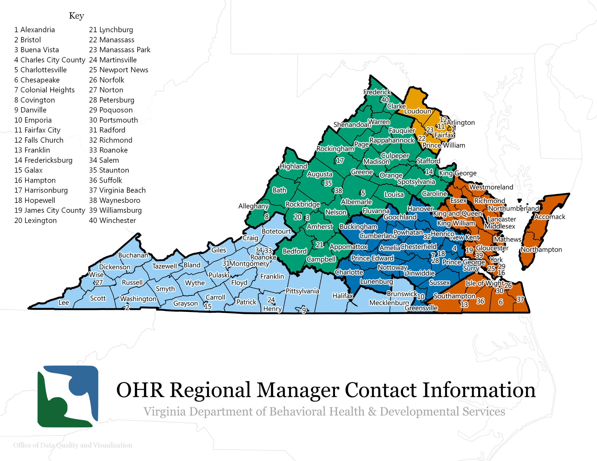
Brandon Rotenberry | 276.783.1219
Brandon.rotenberry@dbhds.virginia.gov
Central State Hospital/Western State Hospital/Eastern State Hospital
Southern VA Mental Health Institute/Northern VA Mental Health Institute/Southwest VA Mental Health Institute
Piedmont Geriatric Hospital/Hiram Davis Medical Center/ Commonwealth Center for Children & Adolescents
VA Center for Behavioral Rehabilitation
State Facilities:
2
Ann Pascoe | 804.297.1503
ann.Pascoe@dbhds.virginia.gov
Cassie Purtlebaugh | 804.382.3889
cassie.purtlebaugh@dbhds.virginia.gov
1
Mandy Crowder| 434.713.1621
Mandy.crowder@dbhds.virginia.gov
3
4
5
Sharae Henderson | 804.524.7479
sharae.henderson@dbhds.virginia.gov
Reginald Daye
757.253.7061
reginald.daye@dbhds.virginia.gov

