Slide 1
Assessment and Intervention for Fall Prevention
Emily Budd, OTR/L, OTD

Slide 2
Objectives
Identify falls as an intervention priority for aging adults
Differentiate among assessments for balance and risk of falling
Examine intervention strategies to prevent falls
Identify resources for fall prevention initiations
Demonstrate implementation of the STEADI initiative for fall prevention strategies

Slide 3
Falls: A Real Problem
1/3 of individuals 65 and older, and 1/2 of individuals 80 and older fall each year
Falls are the leading cause of fatal injury in older adults
800,000 people are hospitalized for falls annually
80% of falls happen in the bathroom
Up to 50% of falls occur as a result of environmental factors
$30,000 to treat one fall
By 2020, $67,000,000,000 to treat falls annually
Notes:
300,000 hospitalizations for hip fractures
Environmental factors: poor lighting, rugs
National Council for Aging Care

Slide 4
Falls: A Real Problem
Fear of Falling
Activity Restriction
Fall
Fear of falling
Activity restriction
Anxiety and depression
Social isolation
Increased risk of falling
Increased dependency on caregivers

Slide 5
IF:
Falls are detrimental for older adults
Most older adults wish to safely age in place
THEN:
What can we do to prevent falls?

Slide 6
STEADI Initiative Stopping Elderly Accidents, Deaths & Injuries

Slide 7
Screen
Performed yearly or after an acute fall with individuals 65+ years old
“Stay Independent” 12-item questionnaire
At risk if ≥4 or fallen in past year
Three Key Questions
Do you feel unsteady when standing or walking?
Are you worried about falling?
Have you fallen in the past year?
At risk if “yes” to any question

Slide 8
If Not At Risk...
Educate on fall prevention
Refer to community program
Rescreen yearly or after an acute fall

Slide 9
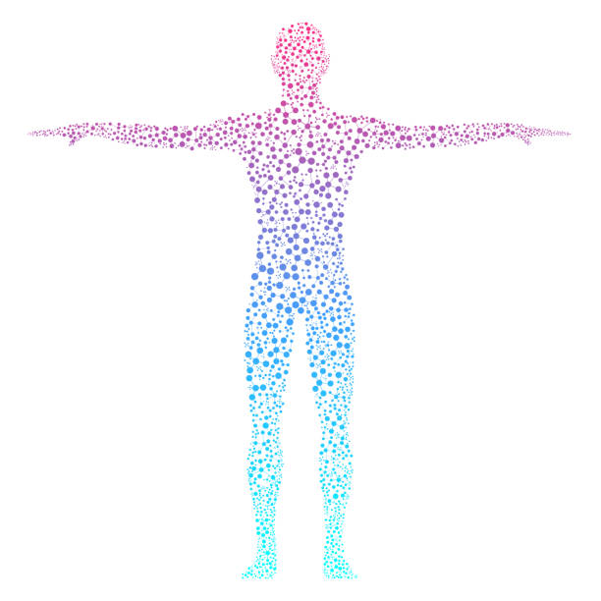
If At Risk...Assess
Assessing balance helps us treat the risk of falling proactively
Evaluate body functions and structures
Range of motion
Strength
Balance

Slide 10
Assessment
Assessing balance helps us treat the risk of falling proactively
Examine general health factors
Remediate strength and balance
Compensate with mobility assistive devices and adaptive equipment
Modify the environment
Connect with community resources
Refer to therapy services

Slide 11
Berg Balance Scale
14 item test measuring static and dynamic standing balance
Includes:
Stool stepping
Transfers
Standing on one leg
Turning
Reaching an item on the floor
Score interpretation correlates with fall risk and recommendation for adaptive equipment
0-20 = high fall risk / wheelchair
21-40 = moderate fall risk / walking with assistance
41-56 = low fall risk / independent
<36 = predictive of fall in the next 6 months
<41 = predictive of multiple falls and injury-causing falls
Notes:
Considered the most widely used balance assessment tool
Free to use, predictive of fall risk and future falls.

Slide 12
Your Turn!
4 = able to hold >10 seconds
3 = able to hold 5-10 seconds
2 = able to hold 3-5 seconds
1 = unable to hold 3 seconds but remains standing
0 = unable, or needs assist to prevent fall
Notes:
Con is that though it measures dynamic balance, there are no mobility components

Slide 13
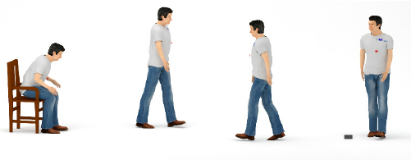
Timed Up and Go (TUG)
Measurement of function during transfer and mobility task
Stand from a chair, walk 10 feet, turn and walk back to the chair, and sit
Use mobility device if needed
≤ 10 seconds = normal
≤ 20 seconds = may require mobility aid
≤ 30 seconds = requires mobility aid
≥ 14 seconds = predictive of high fall risk

Slide 14
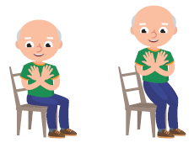
30-Second Chair Stand
With arms crossed over chest, sit to stand from chair as many times as possible in 30 seconds
Below Average Scores = Risk of Falling
Age | Men | Women
60-64 | <14 | <12
65-69 | <12 | <11
70-74 | <12 | <10
75-79 | <11 | <10
80-84 | <10 | <9
85-89 | <8 | <8
90-94 | <7 | <4

Slide 15
4-Stage Balance Test
Demonstrate four test positions and hold the stance for 10 seconds each
Feet together
Staggered stance
Tandem stance
Standing on one foot
No assistive device use, eyes open
Unable to hold tandem stance for 10 seconds = increased risk of falling

Slide 16
Orthostatic Hypotension
A decrease in blood pressure that occurs during a change in position
Check BP after lying down for 5 minutes
Check BP immediately after standing
Check BP 3 minutes after standing
A drop of >20, lightheadedness or dizziness is abnormal

Slide 17
Medication Assessment
Review medication list and schedule a follow-up with doctor to discuss nonpharmacological alternatives
Medications that affect balance:
Anticonvulsants Sedatives
Antidepressants Antihistamines
Antipsychotics Muscle relaxants
Benzodiazepines Medications for blood pressure
Opioids Blood thinners

Slide 18
Vision Assessment
Is the eyeglass prescription current?
Transition lenses
Bifocals

Slide 19
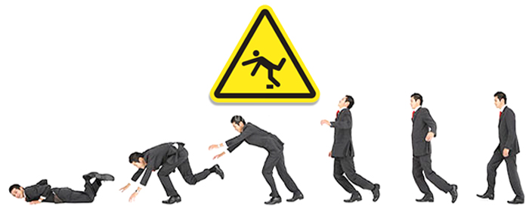
Intervention
Evidence tells us... Falls are preventable!

Slide 20
Referral to Therapy Services
Balance and gait training
Exercise
Training for assistive device use
Environmental modification
Continence training
Multi-factorial fall prevention intervention

Slide 21
Multi-factorial Fall Prevention
Multidisciplinary intervention approach targeting multiple factors that lead to falls:
Vision and hearing screen
Medication review
Home assessment and modification
Self-care training
Falls efficacy and confidence training
Compensatory strategies
Continence
Exercise
Group activities

Slide 22
Exercise

Slide 23
Alternating Lunge
Keeping your back straight, step forward with one foot.
Bend your front knee until your back knee almost touches the floor. Front knee should not pass your toe.
Push through your front leg to return to standing.
Repeat with the opposite leg.
Do 5x on each leg.

Slide 24
Single Leg Stand
Stand with feet hip-width apart. Hold to a chair or wall if needed.
Life one foot off the ground and hold for 10-15 seconds.
Repeat with the opposite foot.
Do 5x on each leg.

Slide 25
Chair Push-Ups
Brace your hands on the arm rests of a chair.
Slowly lift your body out of the chair, using your legs as little as possible.
Slowly return to the chair.
Do 5x.
As this gets easier, try standing without using your arms.

Slide 26
Toe Touches
While standing, slowly roll your shoulders and upper body forward to reach toward your toes.
Keep a slight bend in your knees to protect your back. Reach only as far as your current flexibility allows.
Slowly roll back up to standing.
Do 5x.

Slide 27
Environmental Modification
Remove clutter and throw rugs
Relocate frequently used items to within reach, or use a sturdy stool with a hand rail to reach items
Install grab bars in the bathroom instead of using towel racks or sinks for balance
Place nightlights in all hallways, bathrooms and stairways
Immediately wipe up any spills from the floor
Add hand rails to any steps into the home
Position phone within reach of bed

Slide 28
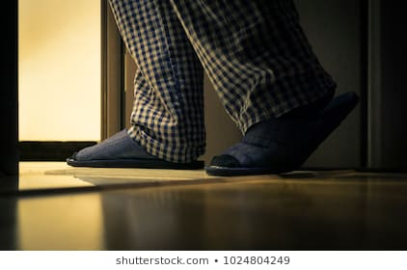
Reduce Falls While Toileting
Occupational therapists can help reduce falls related to toileting in many ways!
Pelvic floor strengthening to reduce urgency and incontinence episodes
Management of clothing and personal care devices
Adaptive equipment to make nighttime toileting more accessible
Strengthening and balance training for mobility to bathroom

Slide 29
Wellness and Group Programs
A Matter of Balance Falls Prevention Program
View falls as controllable and preventable through exercise, goal-setting, assertiveness training, and environmental modification
Tai Chi
Slow movement forms improve flexibility, strength, mindfulness

Slide 30
Other Interventions
Compression stockings prevent orthostatic hypotension
Supportive footwear with sturdy tread; avoid sandals, high heels, or open-back shoes
Wait for glasses to fully transition when going indoors
Use of mobility assistive devices
Referral to podiatrist, ophthalmologist, pharmacist, PCP, as indicated

Slide 31
Case Study: Mr. Ying
Mr. Ying is an 84-year-old Asian male who lives in an apartment that adjoins his son’s house. Mr. Ying is accompanied to this clinic visit by his son who assists with the history. Although previously outgoing and social, Mr. Ying recently has been limiting his outside activities.

Slide 32
Medical History
Reports he feels dizzy when he stands up
Uses a cane outside the house, uses furniture to support himself in the house
No falls, but reports fear of falling and becoming a burden to his family
Medical record includes spinal stenosis, depression, GERD, hypertension, hyperlipidemia, glaucoma
Toilets >2 times per night
Requires assist for bathing

Slide 33
Assessment
Score of “4” on Stay Independent assessment
TUG score: 15 seconds with cane
30-Second Chair stand: 9
4-Stage Balance Test: 10 seconds side by side; 3 seconds staggered stance
Vitals:
BP supine: 135/76
BP sitting: 112/75
BP standing: 116/76

Slide 34
Intervention
Implement strategies to reduce orthostatic hypotension
Compression stockings
Increased water intake
Referral to PT for cane use and increasing balance
Referral to OT for bathing, toileting, and home modification
Increase lighting to the bathroom at night
Refer to ophthalmologist for management of low vision
Establish exercise regimen or wellness program

Slide 35
Resources for Professionals
STEADI toolkit can be downloaded from: https://www.cdc.gov/steadi/materials.html
A Matter of Balance website: https://mainehealth.org/healthy-communities/healthy-aging/matter-of-balance
Tai Chi for Health Institute website: https://taichiforhealthinstitute.org/
National Council on Aging Fall Prevention Resources: https://www.ncoa.org/center-for-healthy-aging/falls-resource-center/
Centers for Disease Control and Prevention Guide to Establishing Fall Prevention Programs: https://www.cdc.gov/homeandrecreationalsafety/pdf/falls/FallPreventionGuide-2015-a.pdf
American Occupational Therapy Association Fall Prevention Tipsheet: https://www.aota.org/~/media/Corporate/Files/AboutOT/consumers/Adults/Falls/Fall%20Prevention%20Tip%20Sheet.pdf

Slide 36
Questions?

Slide 37
References
American Occupational Therapy Association (2012). Fall prevention for older adults. Accessed from file:///C:/Users/Emily/Documents/Fall%20Prevention/Fall%20Prevention%20Tip%20Sheet.pdf
Centers for Disease Control (2017). STEADI: Older adult fall prevention. Accessed from https://www.cdc.gov/steadi/materials.html
Fetters, A. (2017). The six best exercises for preventing falls in older adults. U.S. News & World Report.
National Council for Aging Care (2018). Fact sheet: Falls. Accessed from https://www.aging.com/falls-fact-sheet/.
National Council on Aging (2019). Evidence based fall prevention programs. Accessed from https://www.ncoa.org/healthy-aging/falls-prevention/falls-prevention-programs-for-older-adults-2/

